Slide 1
Equity analysis of MIYCN data in Southeast Asia
Cambodia Report
November 2022

Slide 2
Overview
Key Findings
Recommendations
Next steps
Methodology
Limitations
Notes

Slide 3
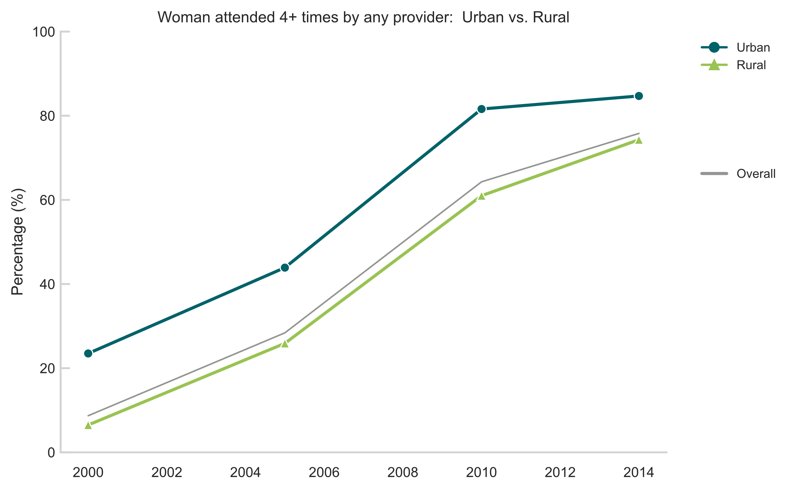
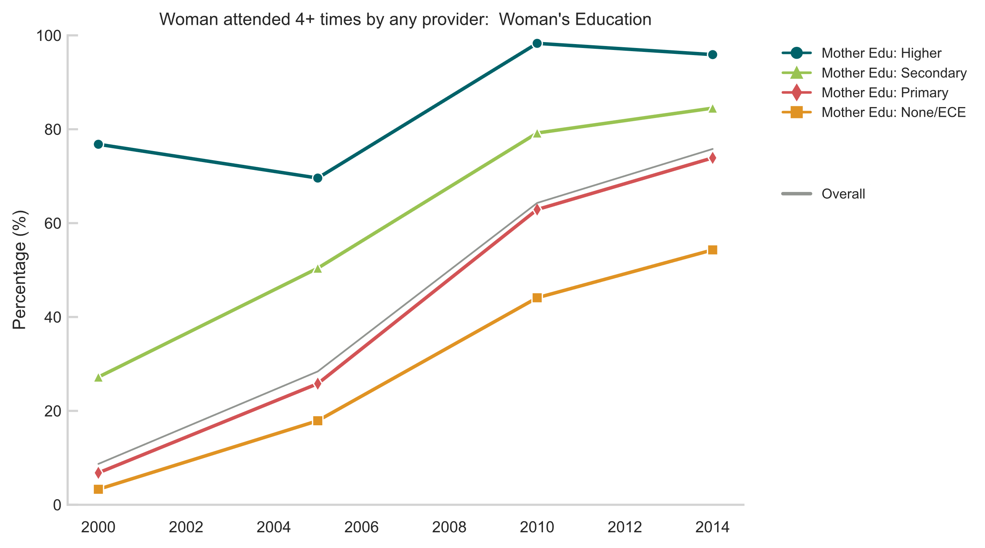
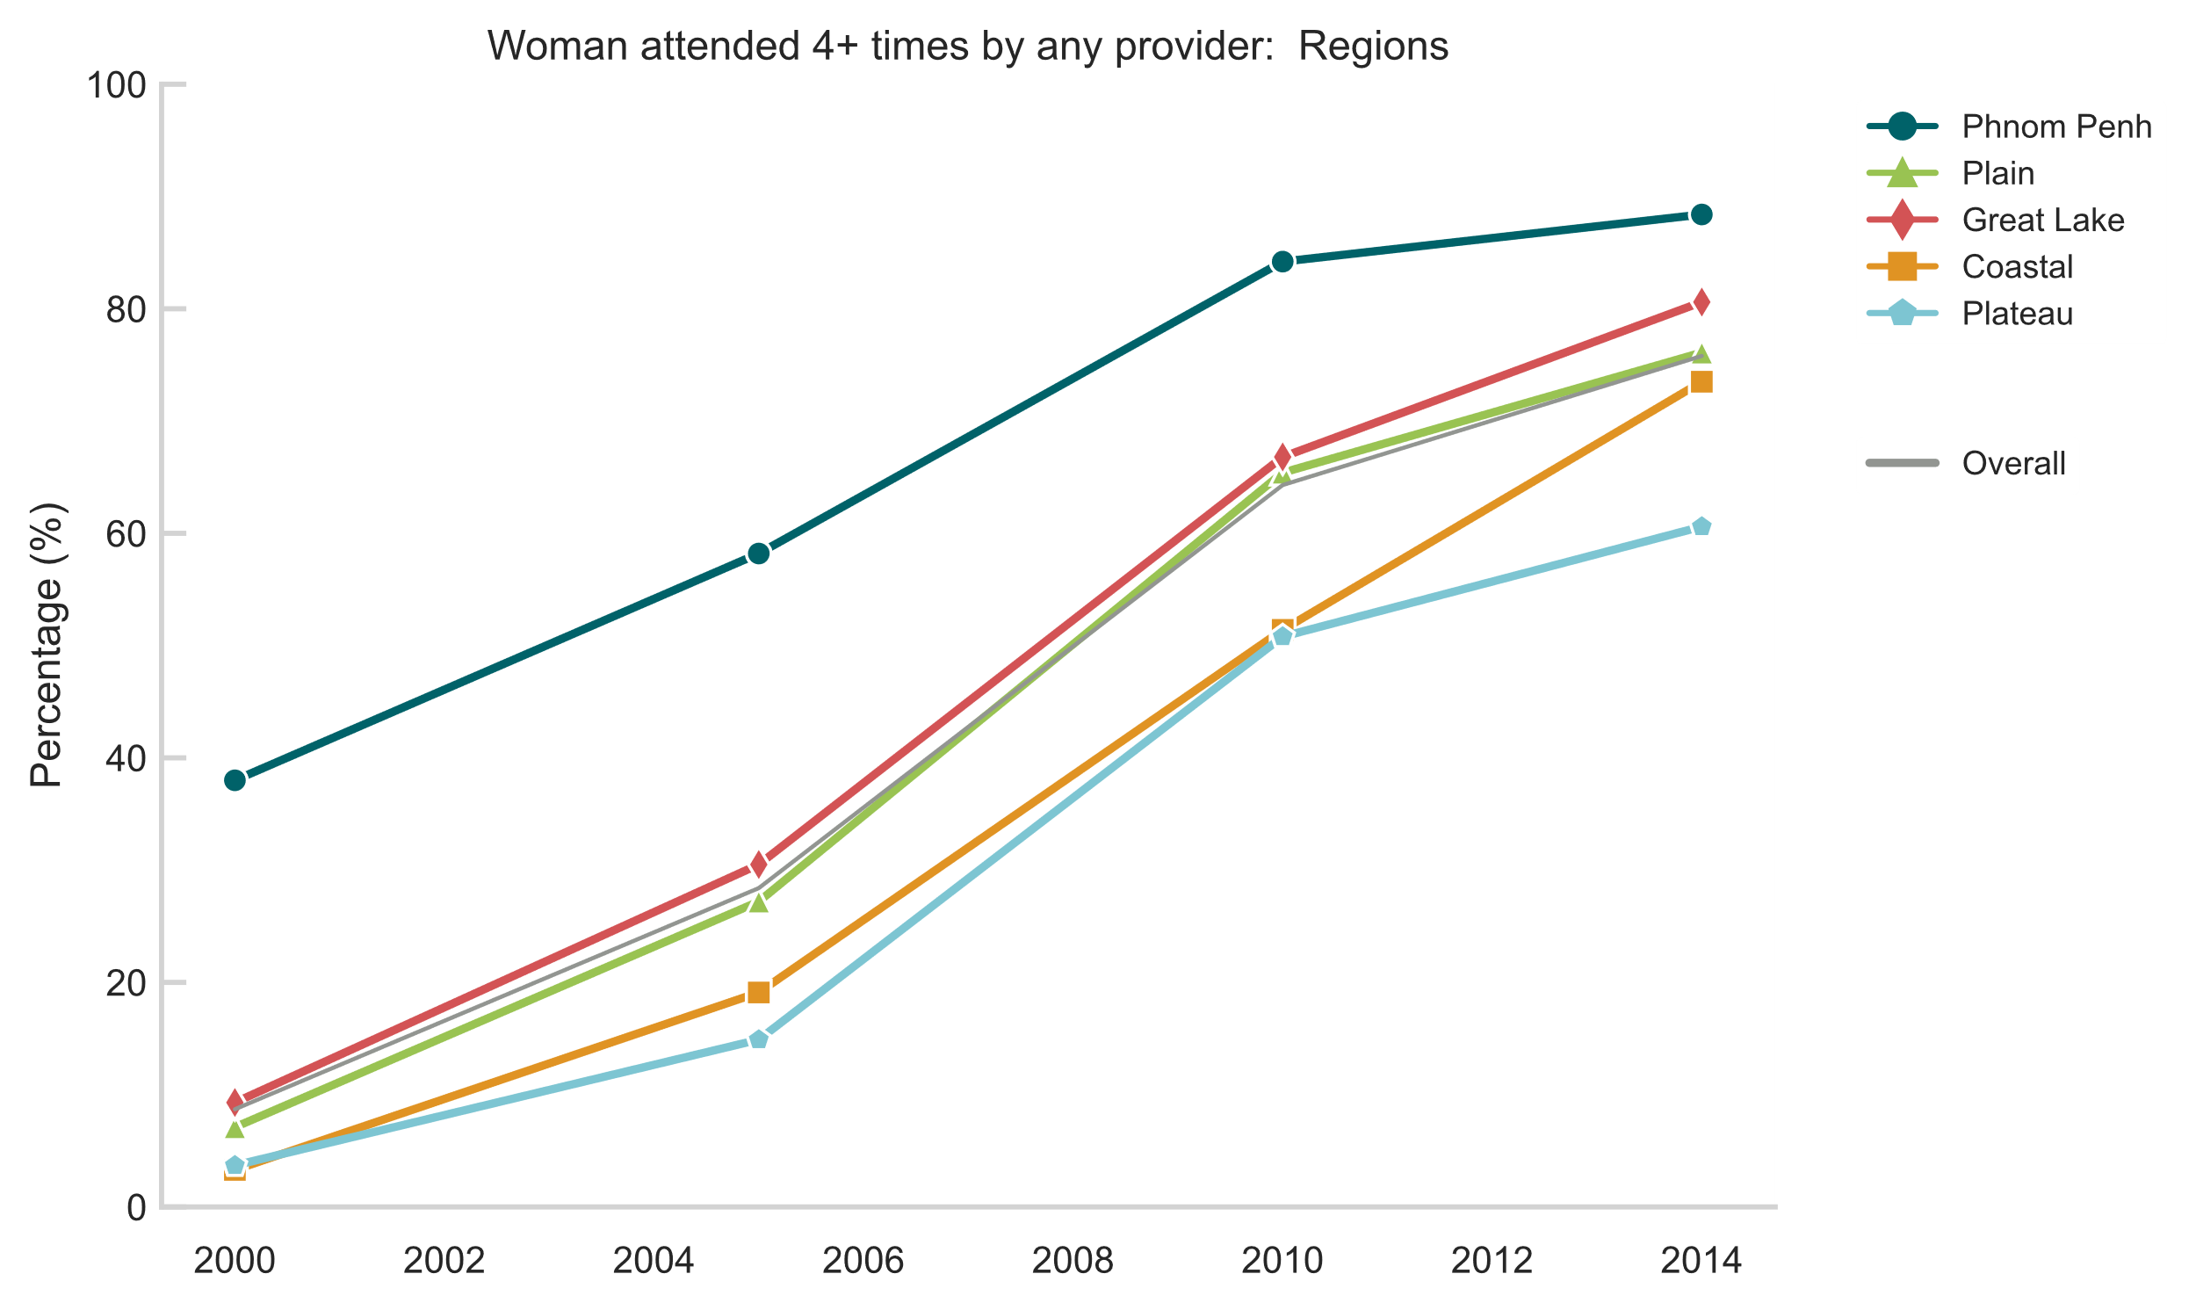
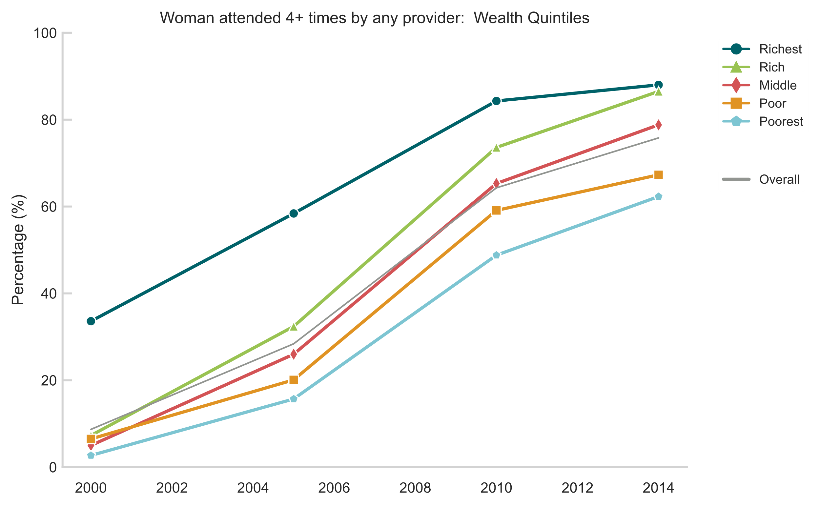
ANC 4+ visits
Large scale improvements in overall access to ANC for mothers in Cambodia
Significant improvements in the equity gaps over time for urban/rural, region and mother’s education
Equity gap between women from the richest and poorest households did not significantly improve over the review period
Definition: Percentage of women aged 15-49 years with a live birth in the last 2 years who during the pregnancy of the most recent live birth received antenatal care, four times or more times from any provider.

Slide 4
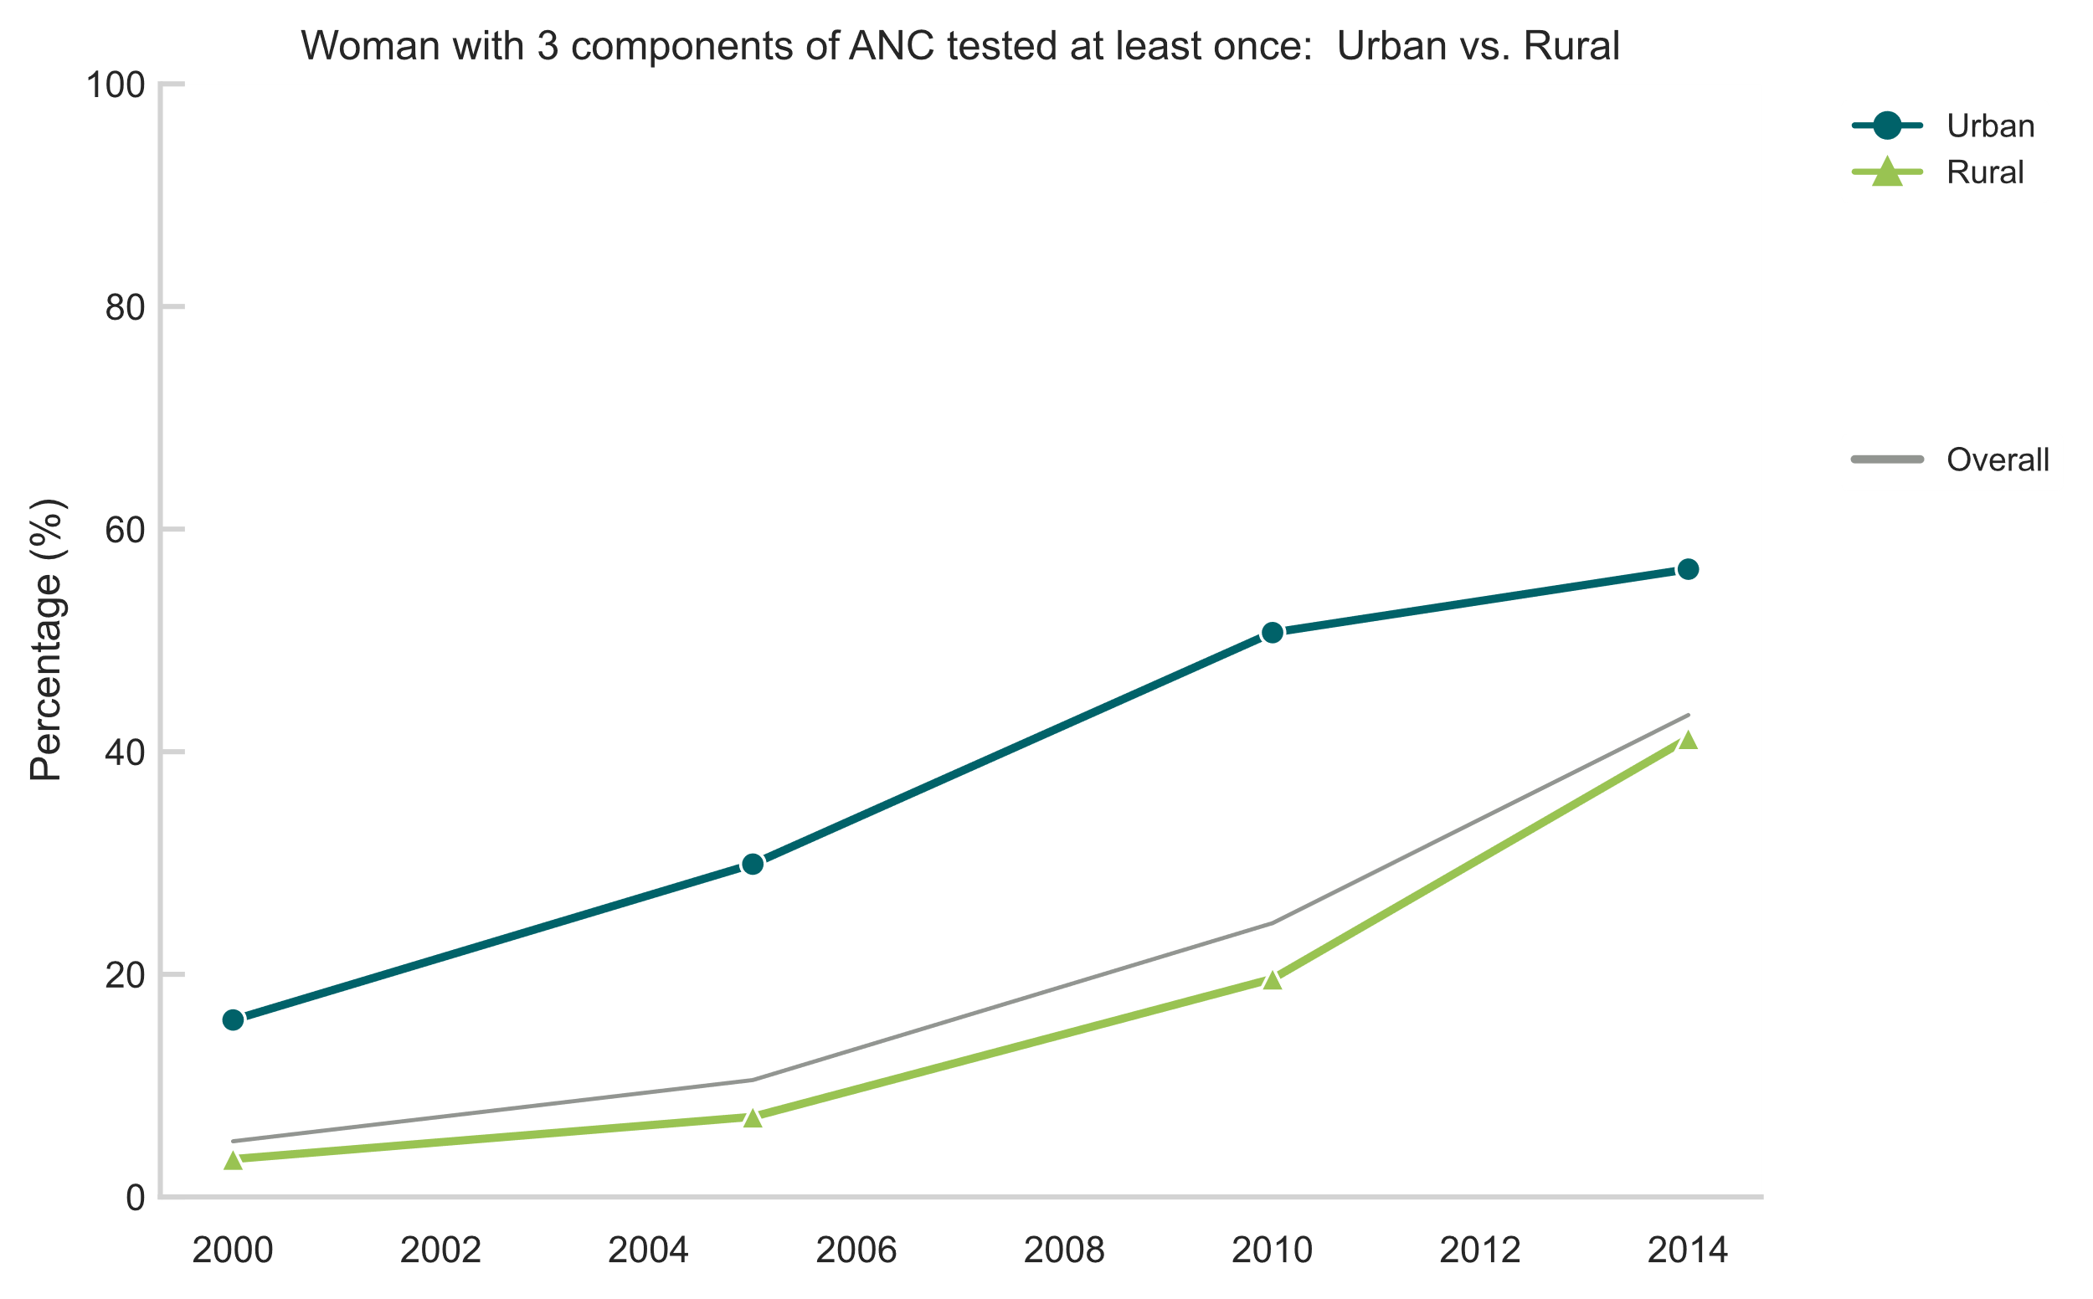
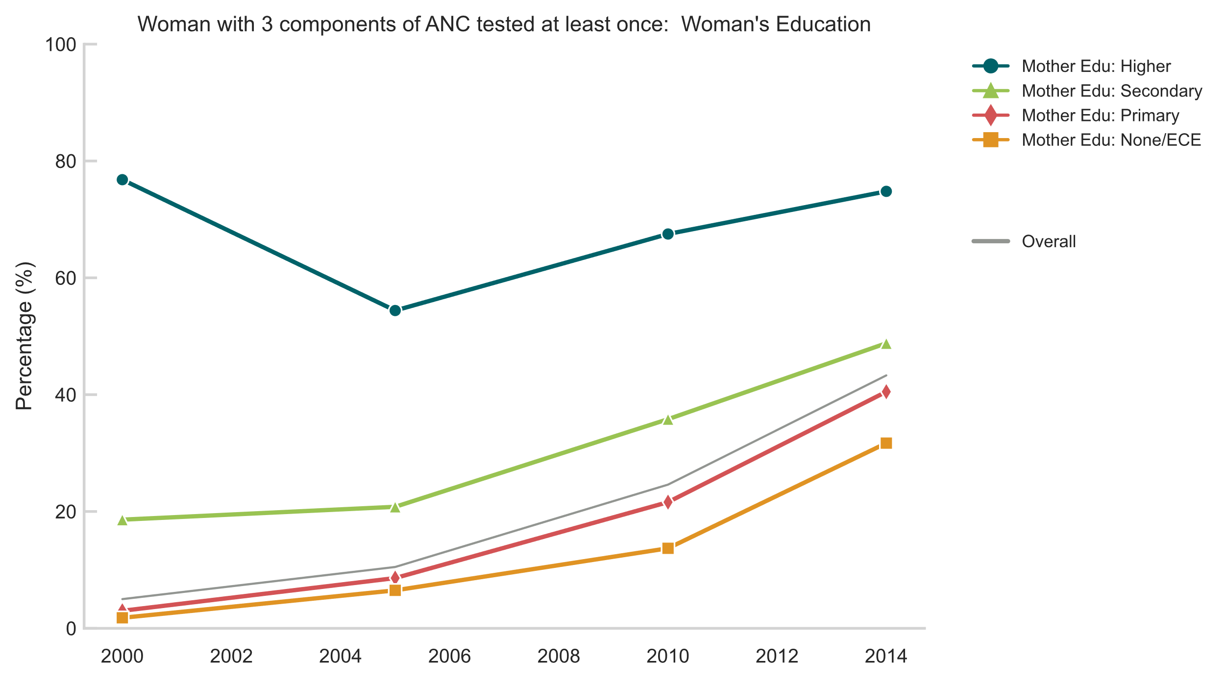
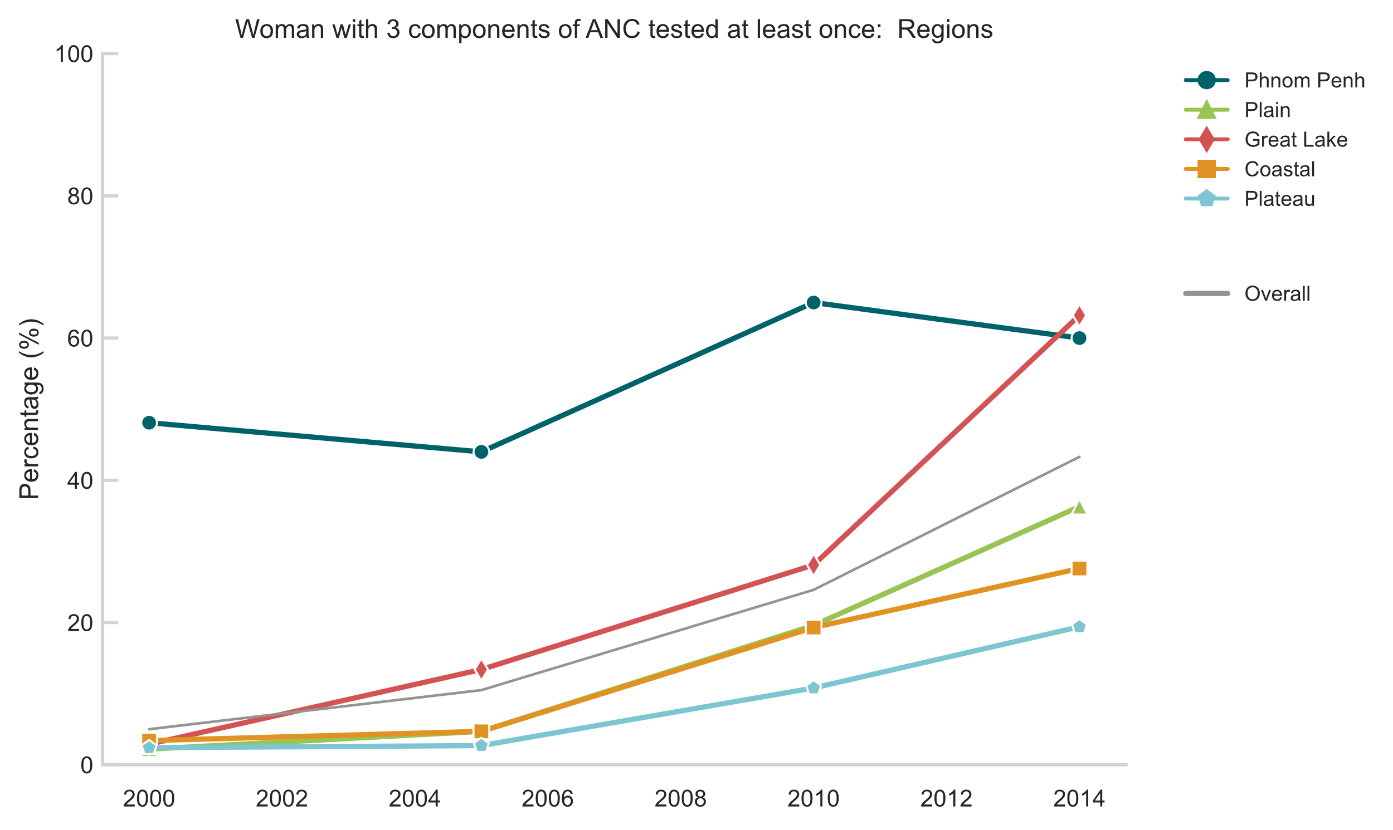
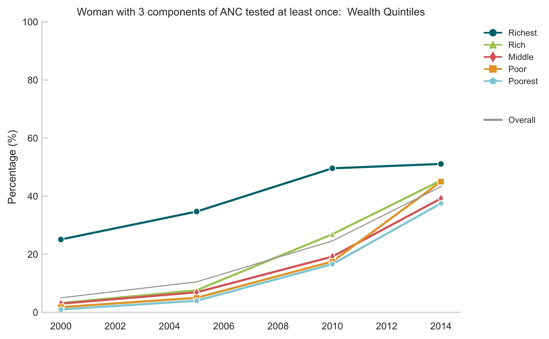
ANC 3 components
Improvements overall for access to quality ANC but, compared to near universal access to ANC 4+, suggests further improvements are possible
Narrowing of equity gap observed for region and wealth quintiles; plateauing of progress for wealthiest group a cause for concern (suggests a possible ceiling)
Same leveling off observed in urban areas whereas rural areas still displaying accelerating trends
Definition: Percentage of women aged 15-49 years with a live birth in the last 2 years who during the pregnancy of the most recent live birth, at least once, had blood pressure measured and gave urine and blood samples as part of antenatal care

Slide 5
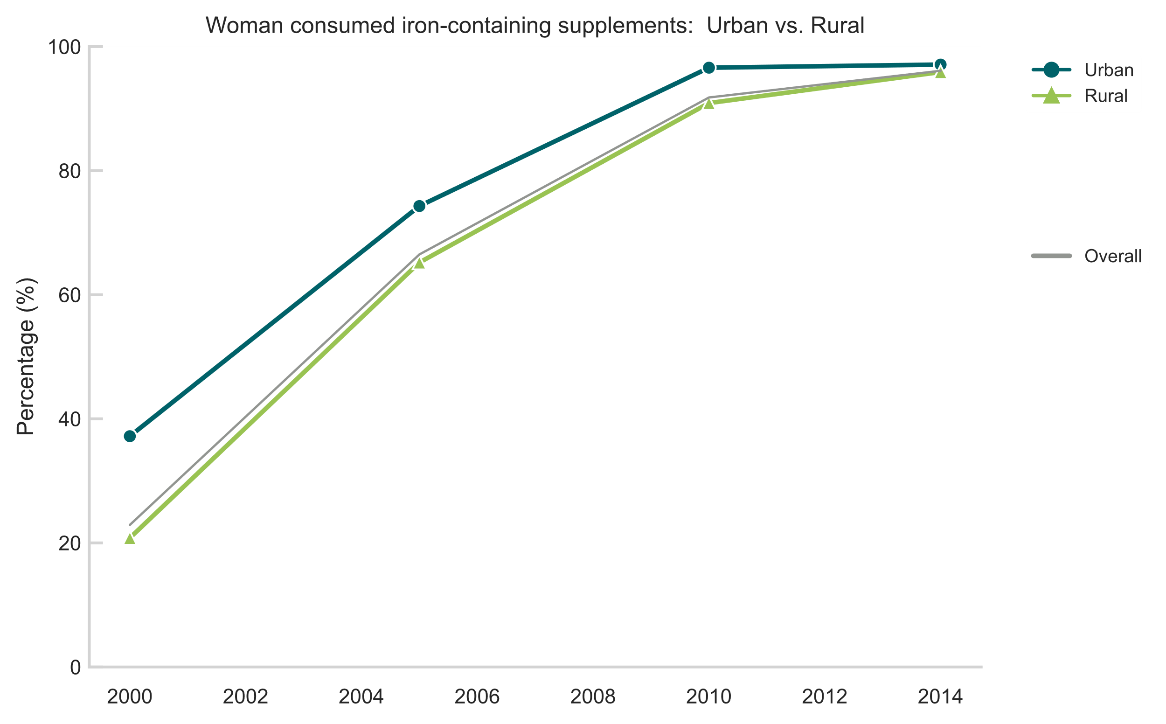
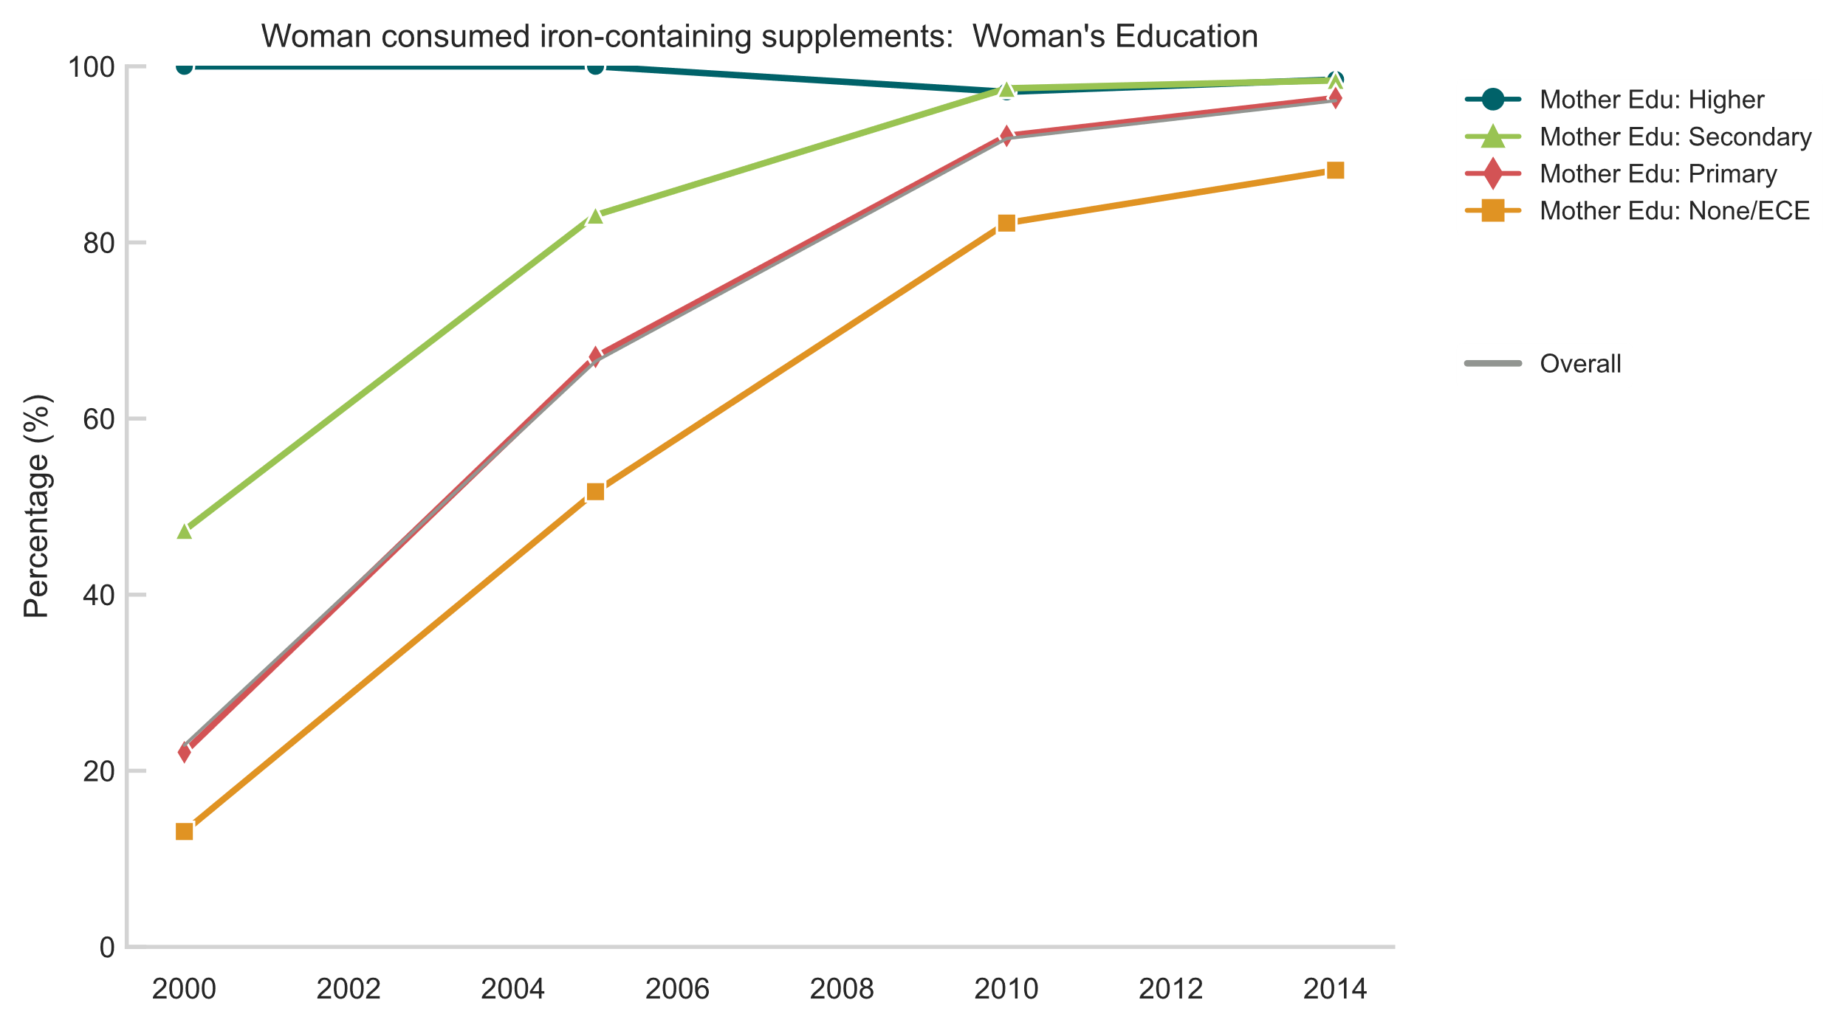
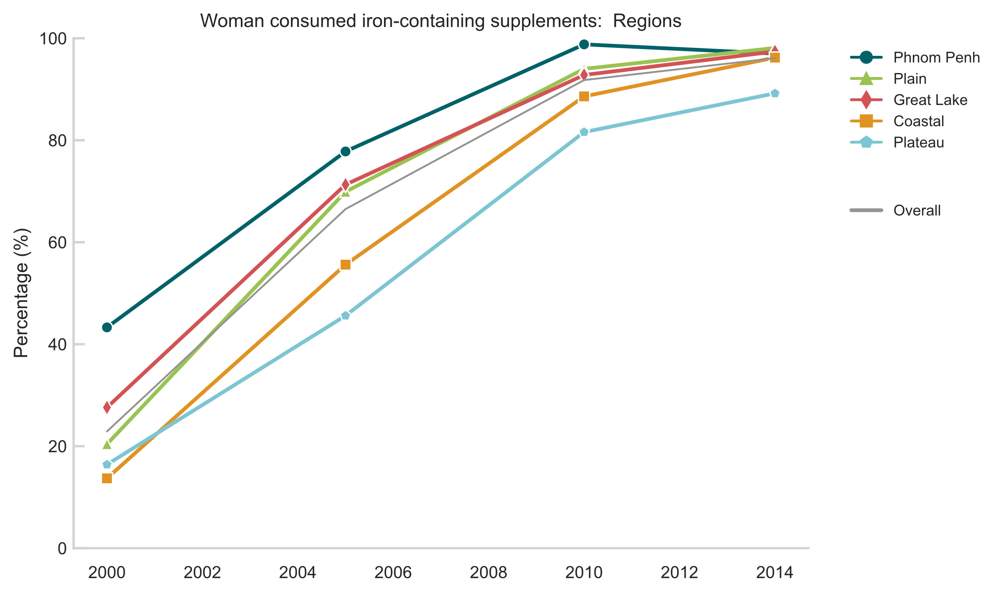
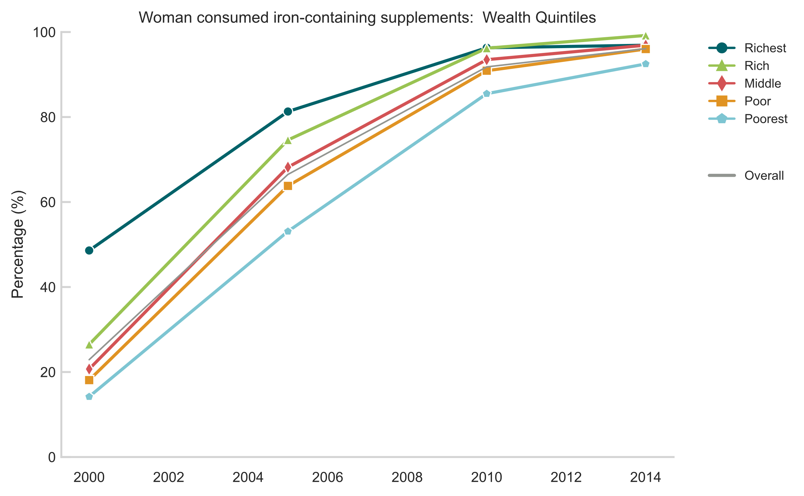
Iron Supplementation
In contrast to Lao PDR, equity gaps narrowed significantly for most subgroups across the review period
Findings indicate that access to basic health services are widespread within Cambodia and not largely dependent on socioeconomic characteristics
Definition: Percentage of women aged 15-49 years with a live birth in the last 2 years who during the pregnancy of the most recent live birth consumed any iron-containing supplements
Notes:
Data not collected in 2006

Slide 6
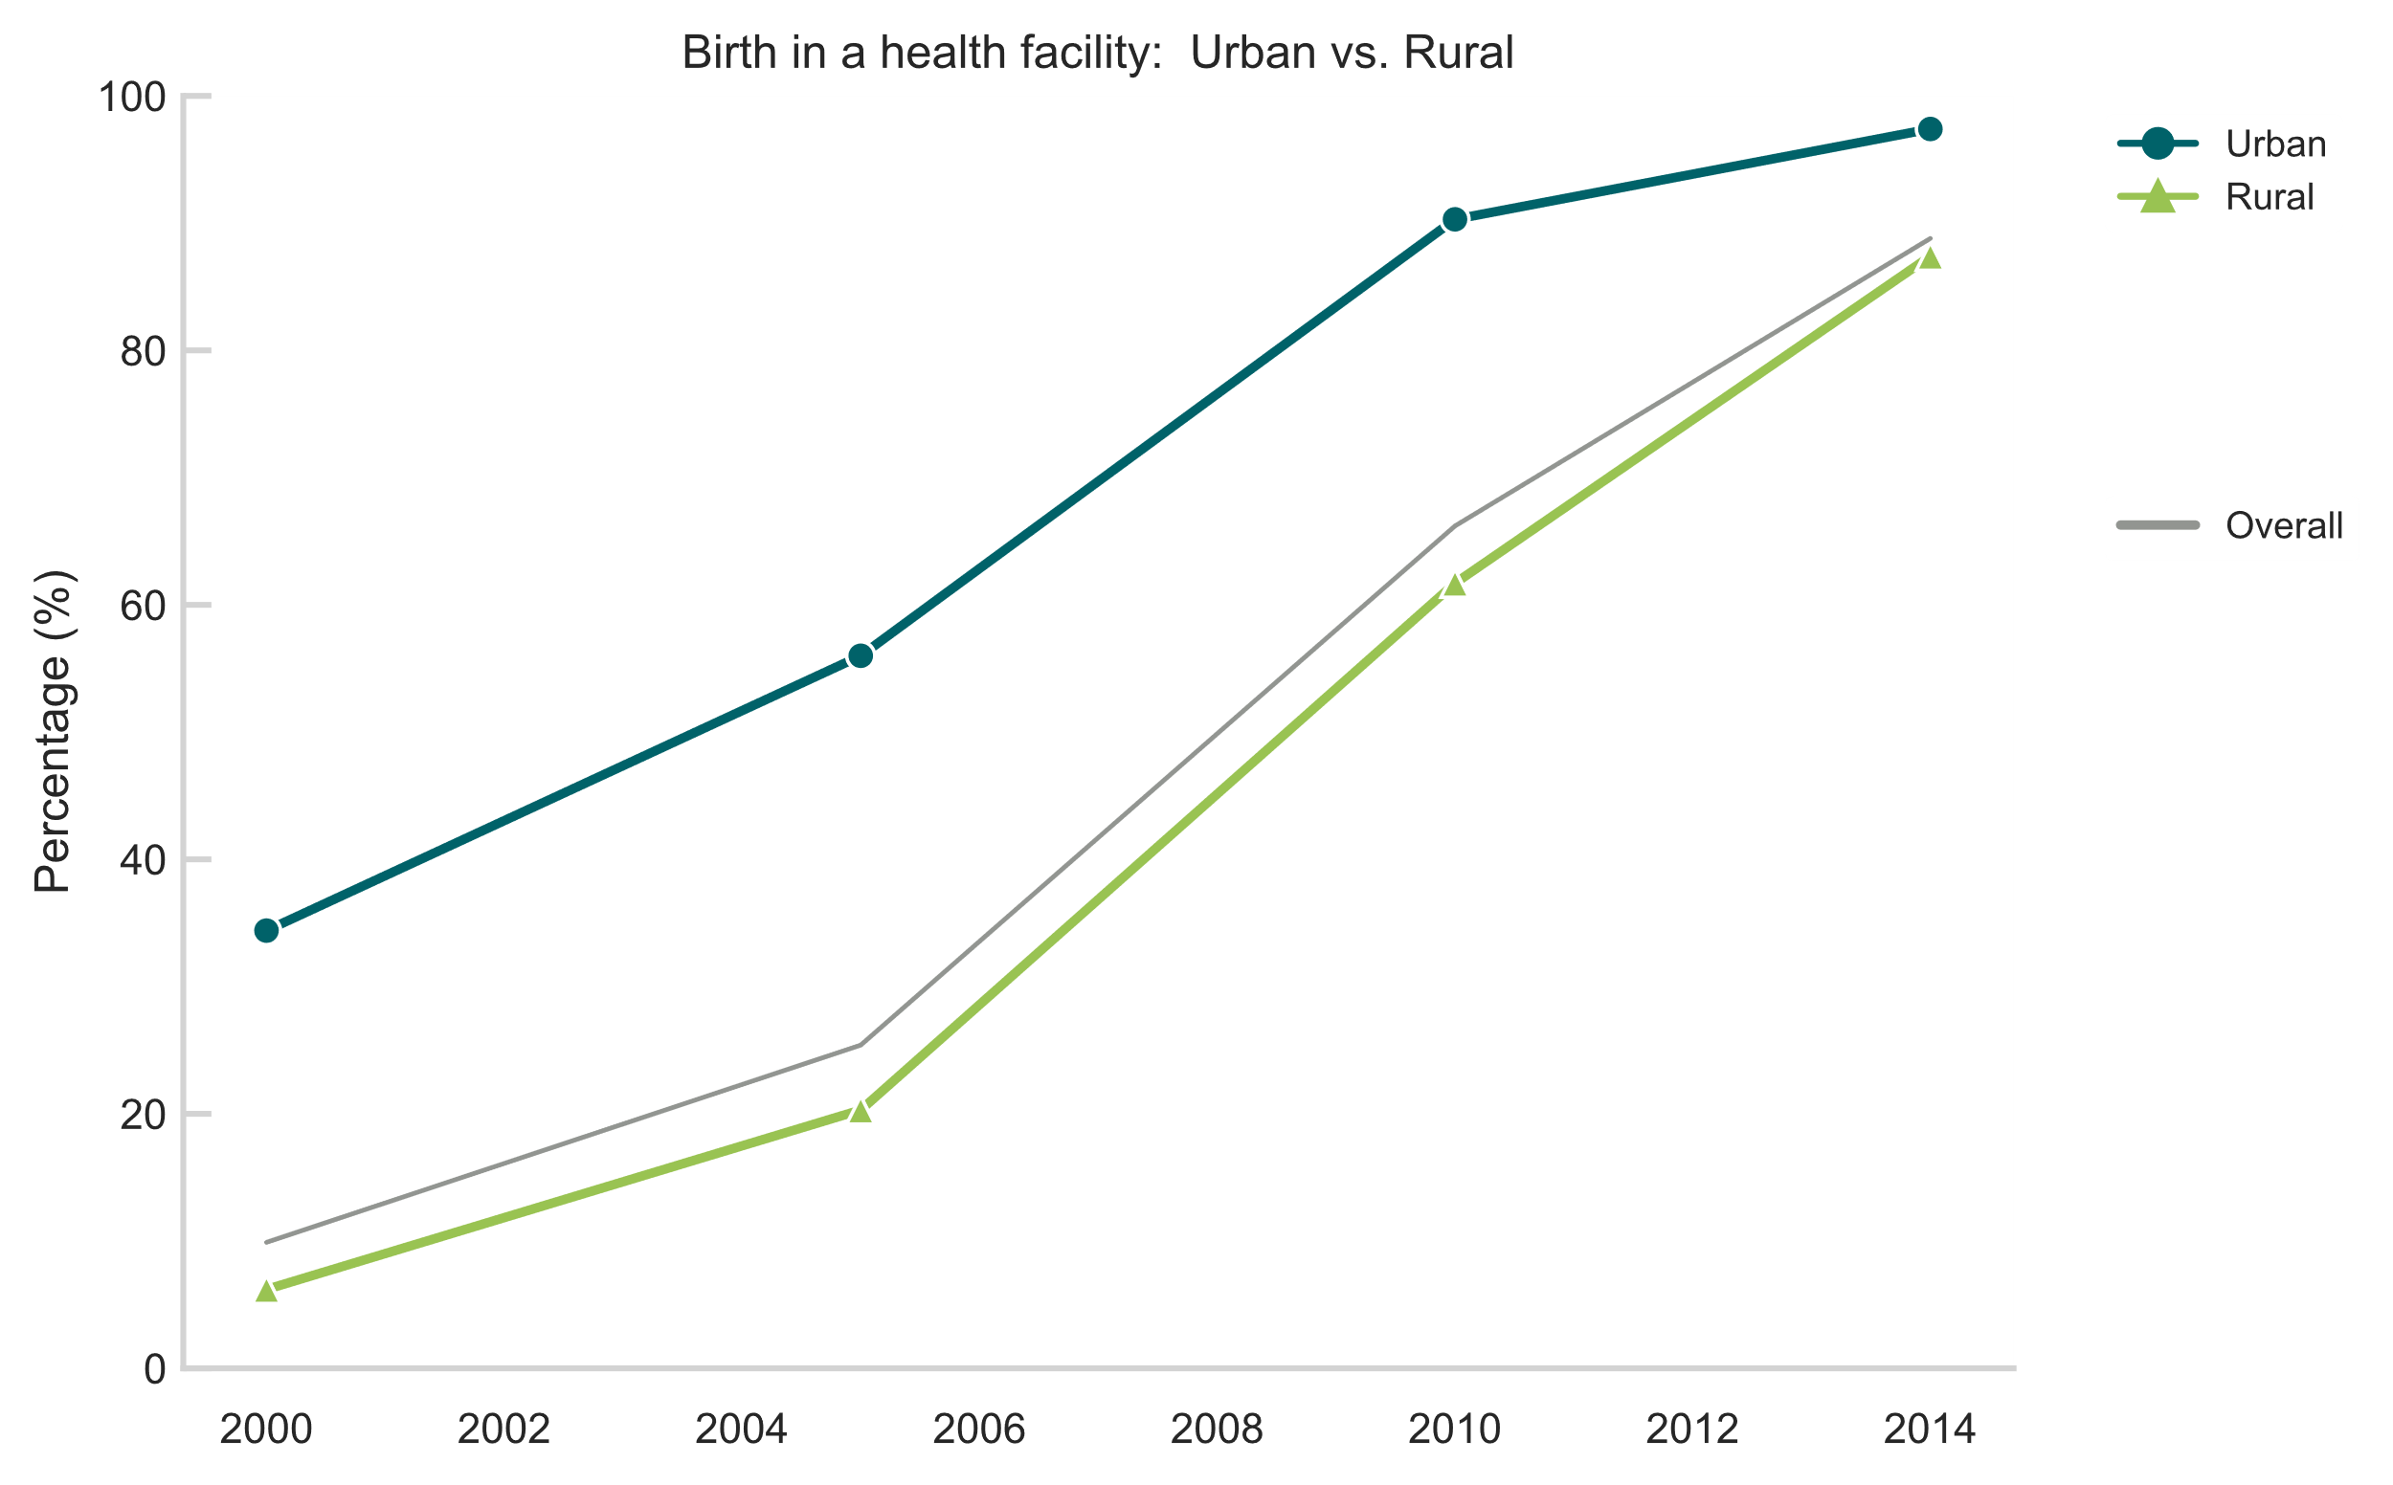
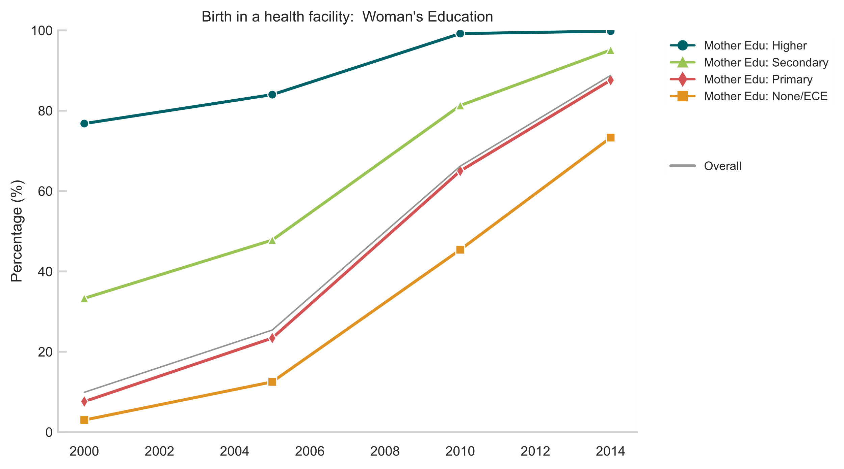
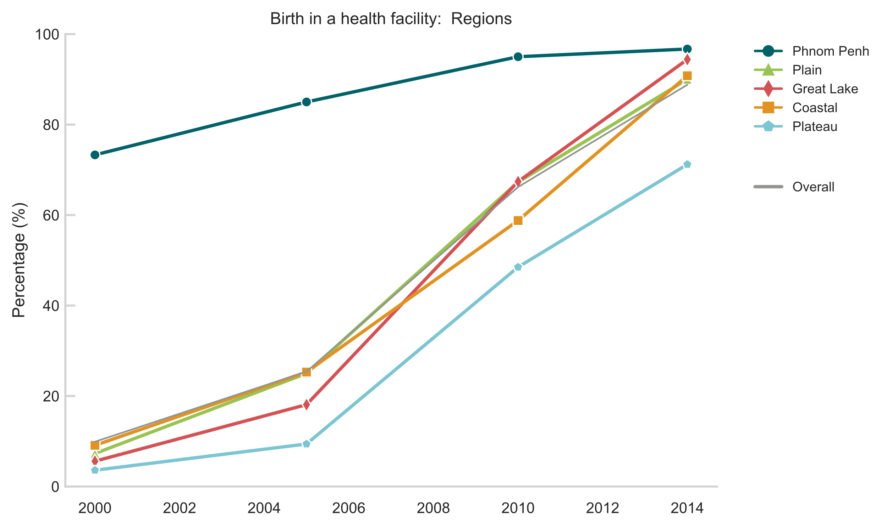
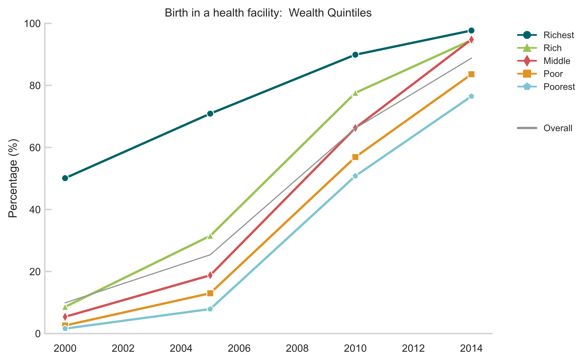
Institutional birth
Very strong, positive trend across all equity subgroups, significantly narrowing for urban/rural, region, mother’s education and wealth over the review period
As in Lao PDR, existing gaps by region and wealth suggest more room for improvement. Rate of change for Plateau region not as fast since 2010 as other regions.
Definition: Percentage of women aged 15-49 years with a live birth in the last 2 years whose most recent live birth was performed in a health facility.

Slide 7
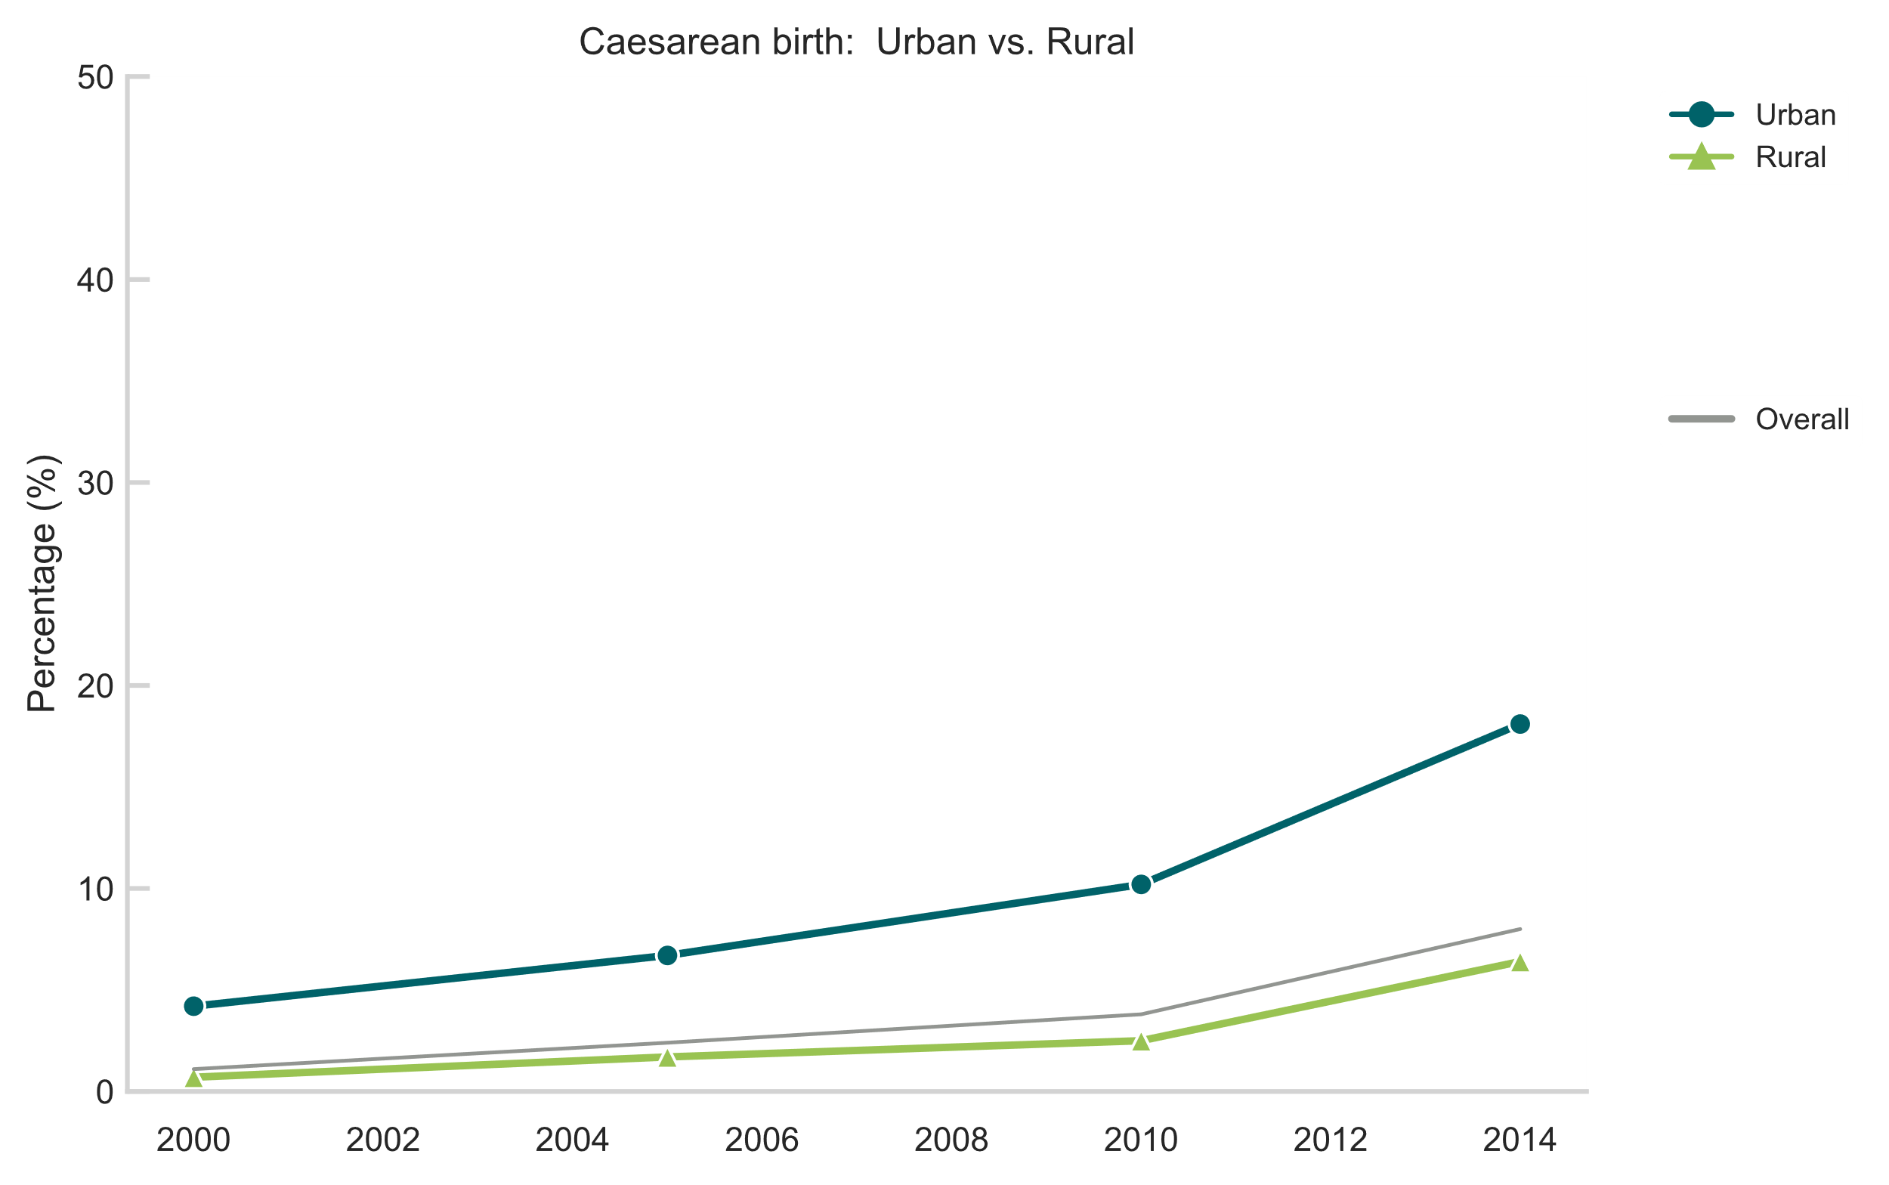
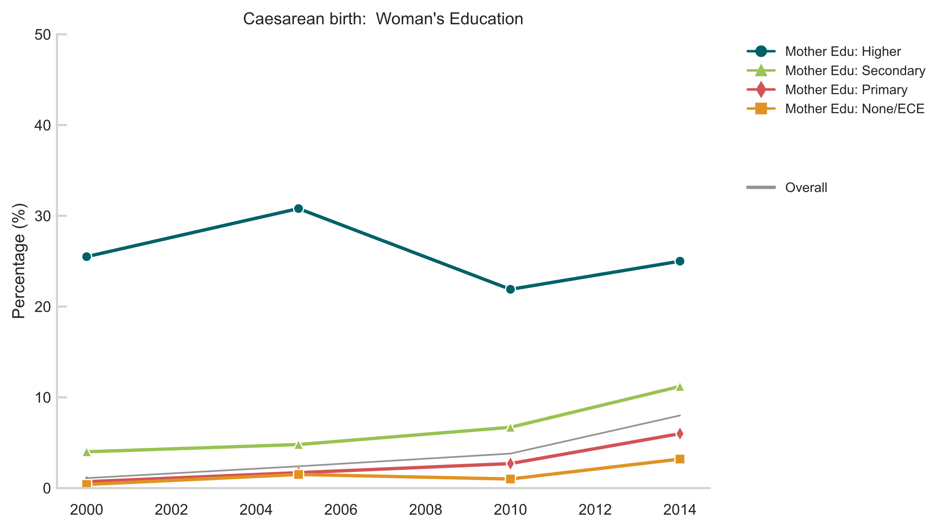
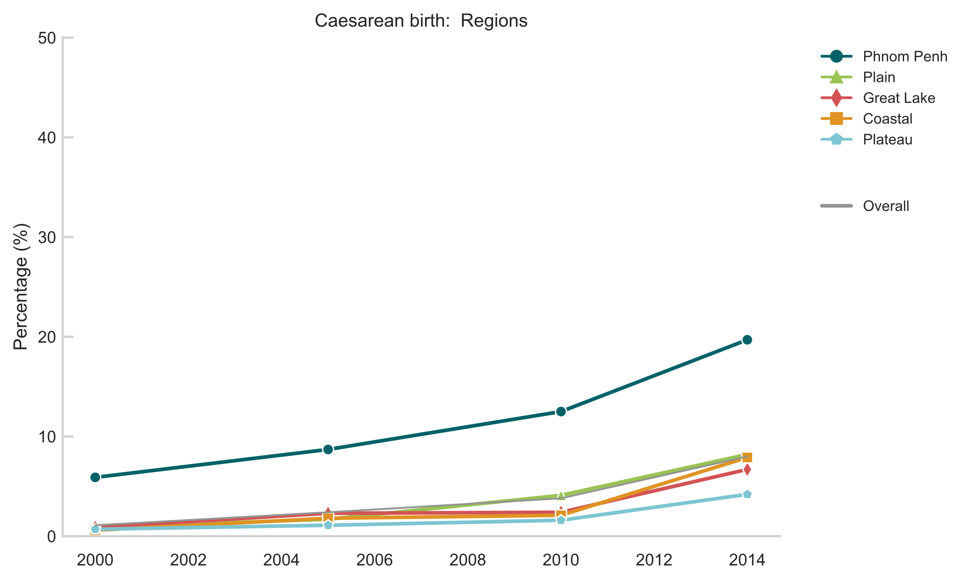
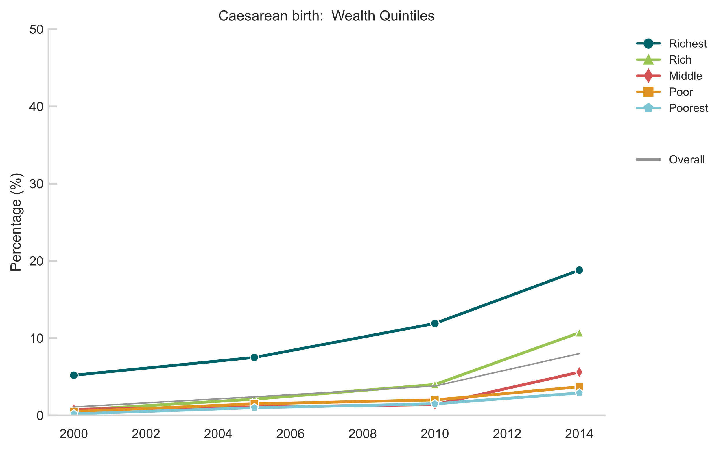
Caesarean birth
As of 2014, caesarean birth in Cambodia remains strictly for women of the highest socioeconomic backgrounds
Equity gaps widened significantly for urban/rural, mother’s education and wealth owing to the acceleration since 2010
Definition: Percentage of women aged 15-49 years with a live birth in the last 2 years whose most recent live birth was performed by caesarean section.

Slide 8
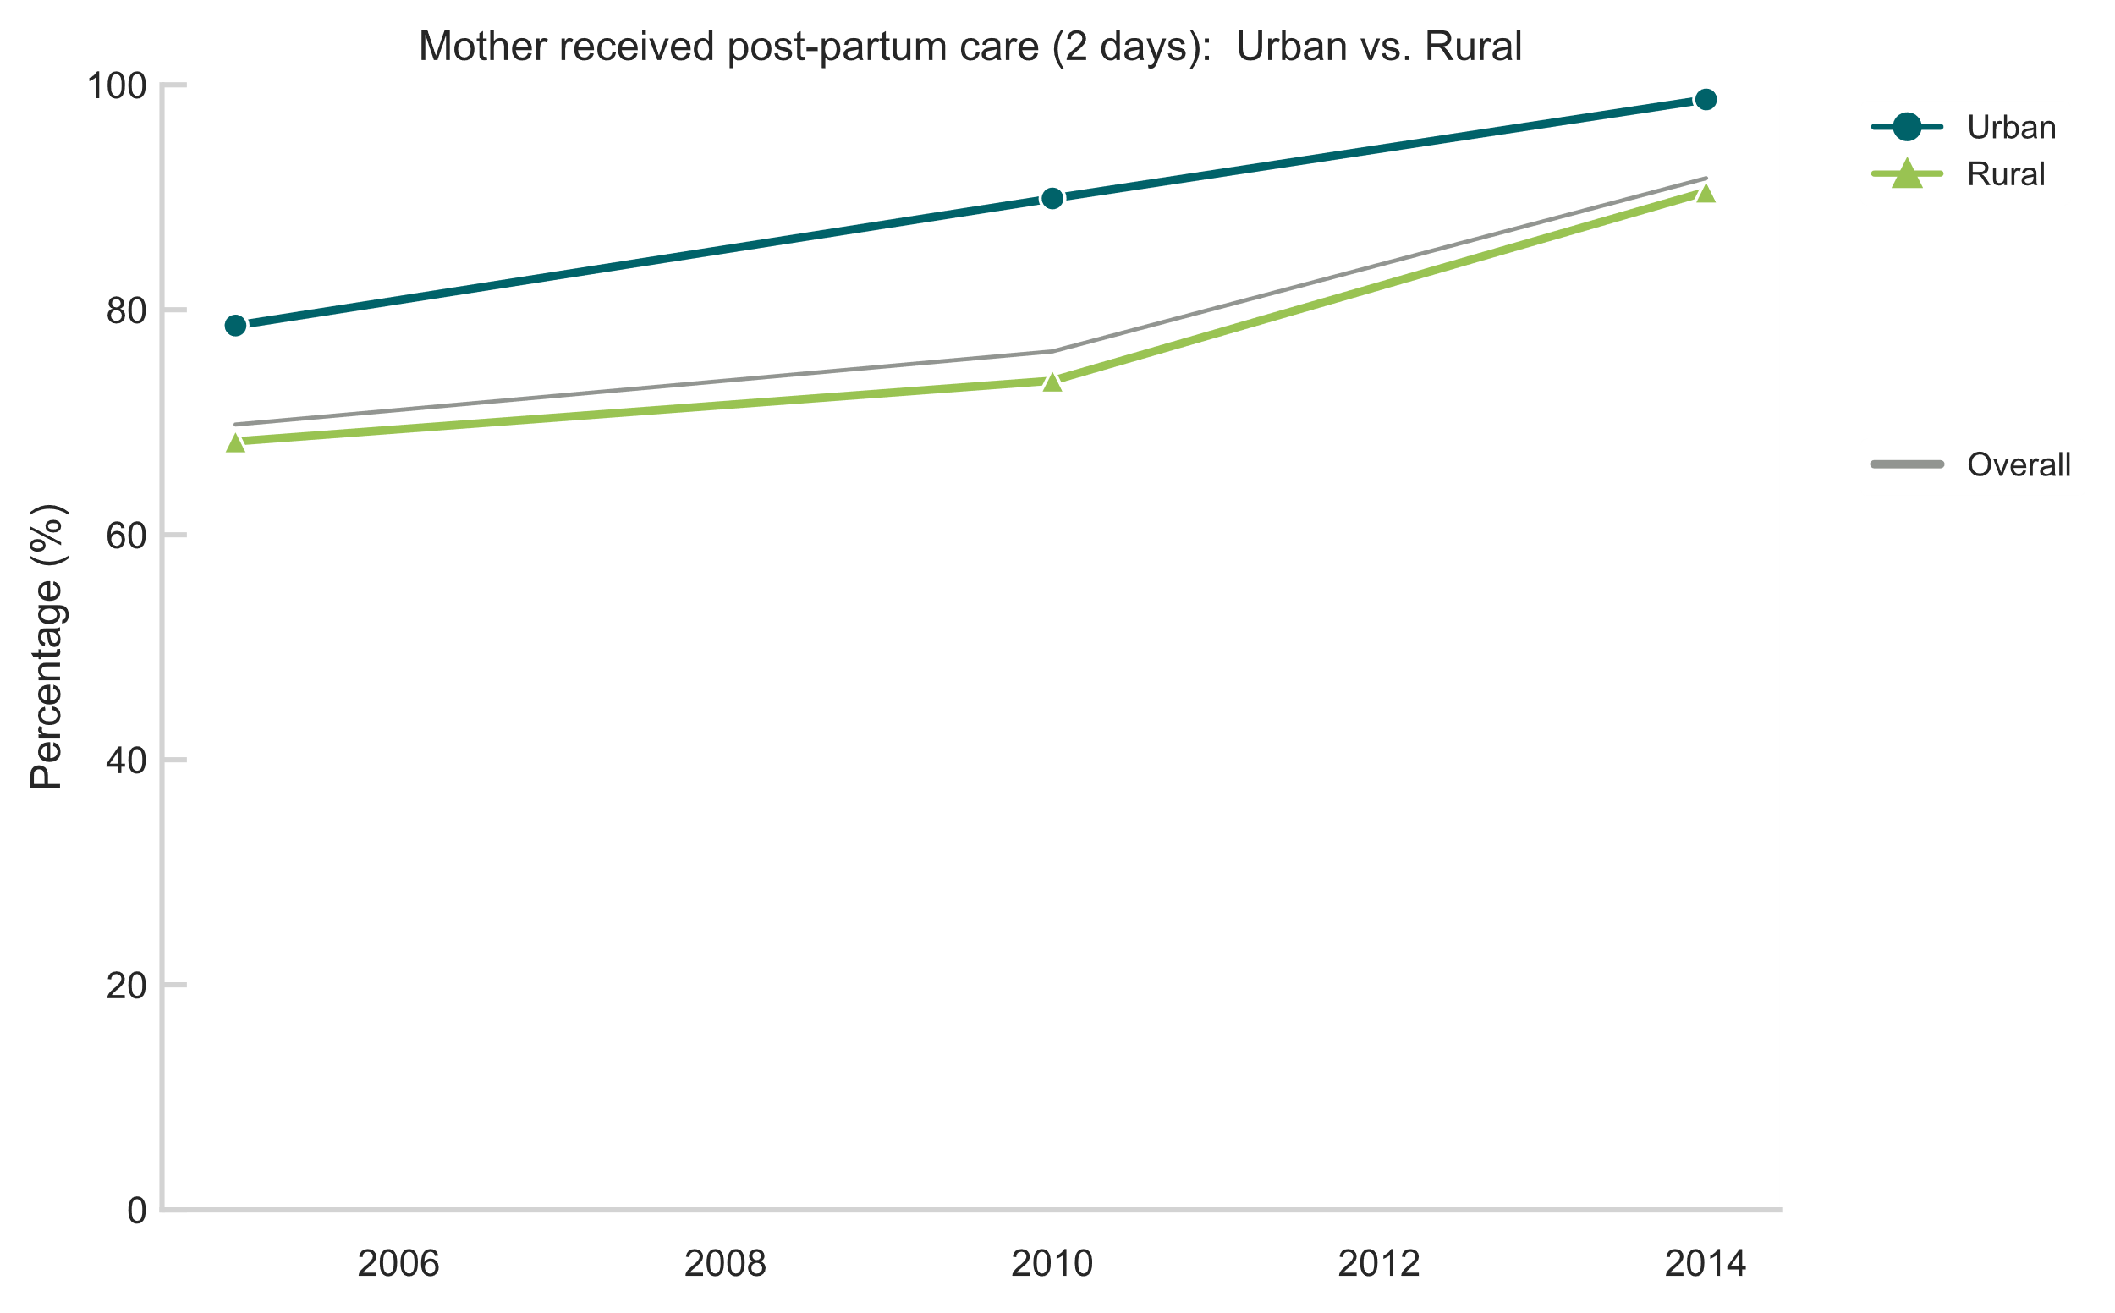
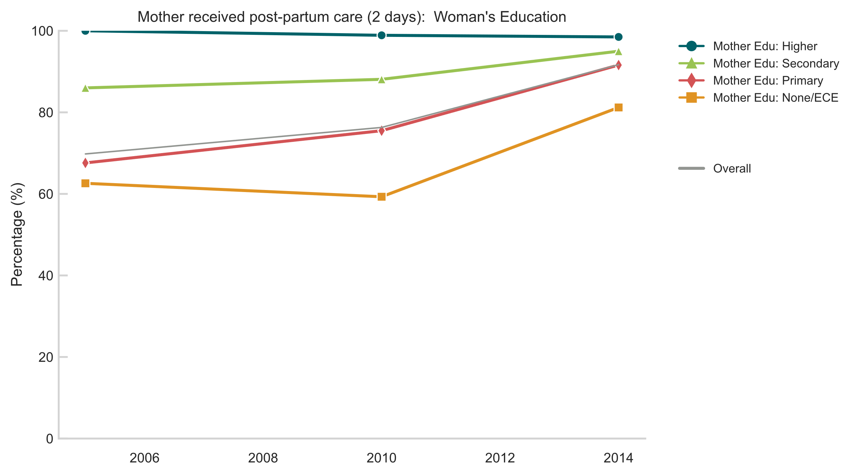
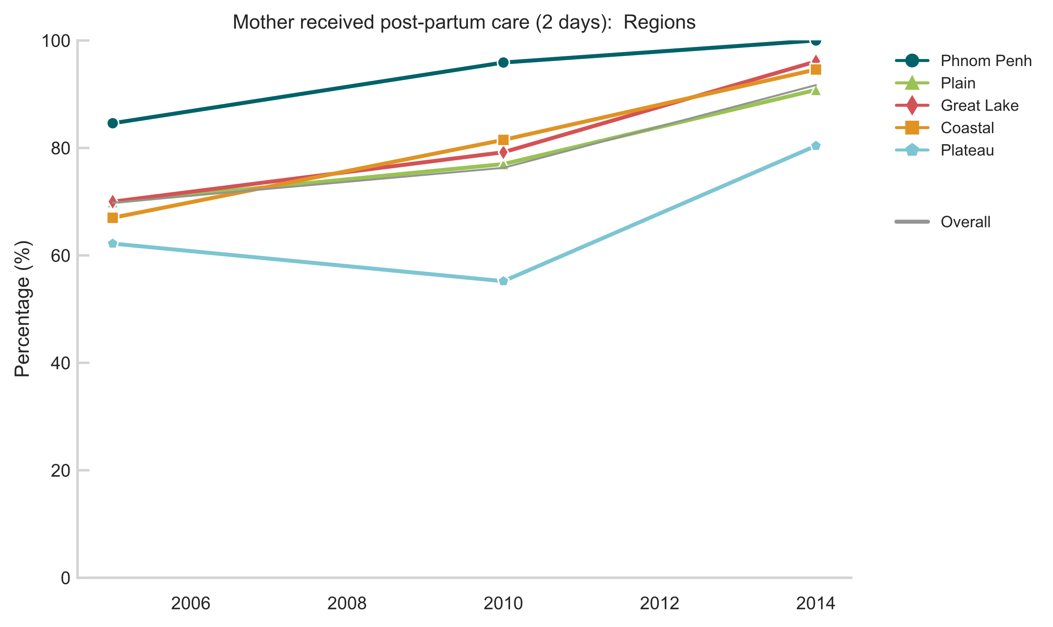
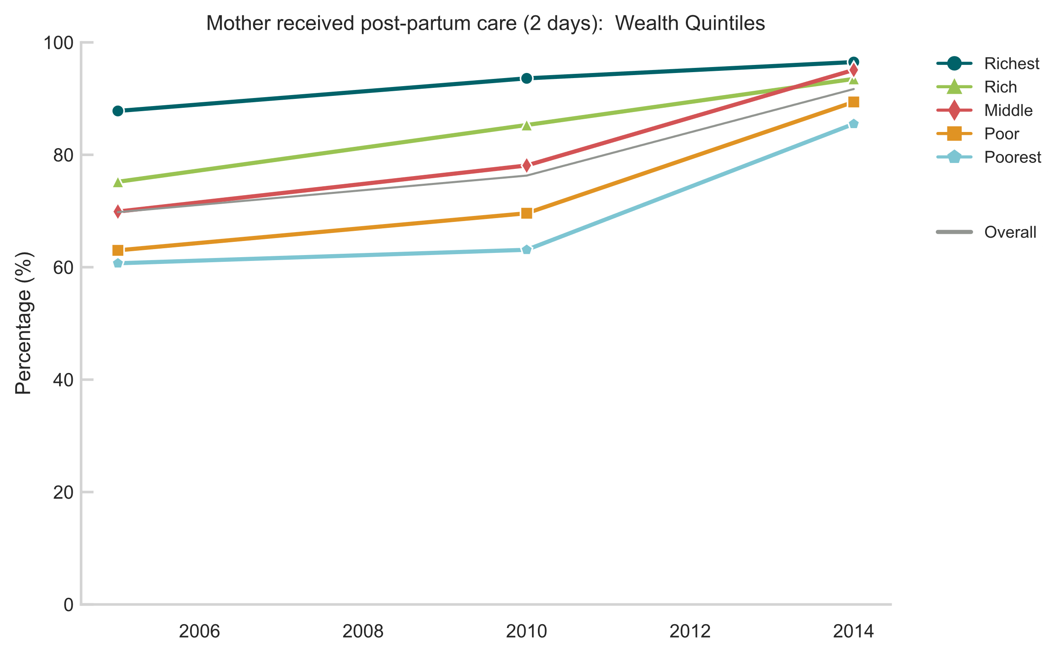
Post-natal care (mother)
In contrast to Lao PDR, near universal access to PNC for mothers in Cambodia, likely owing to near universal facility delivery
Small (but significant) narrowing across mother’s education and wealth equity subgroups
Gap for region did not materially narrow suggesting possible room for further improvement in Plateau region
Definition: Percentage of women aged 15-49 years with a live birth in the last 2 years for whose most recent live birth received postpartum contact with a health provider within 2 days of delivery.

Slide 9
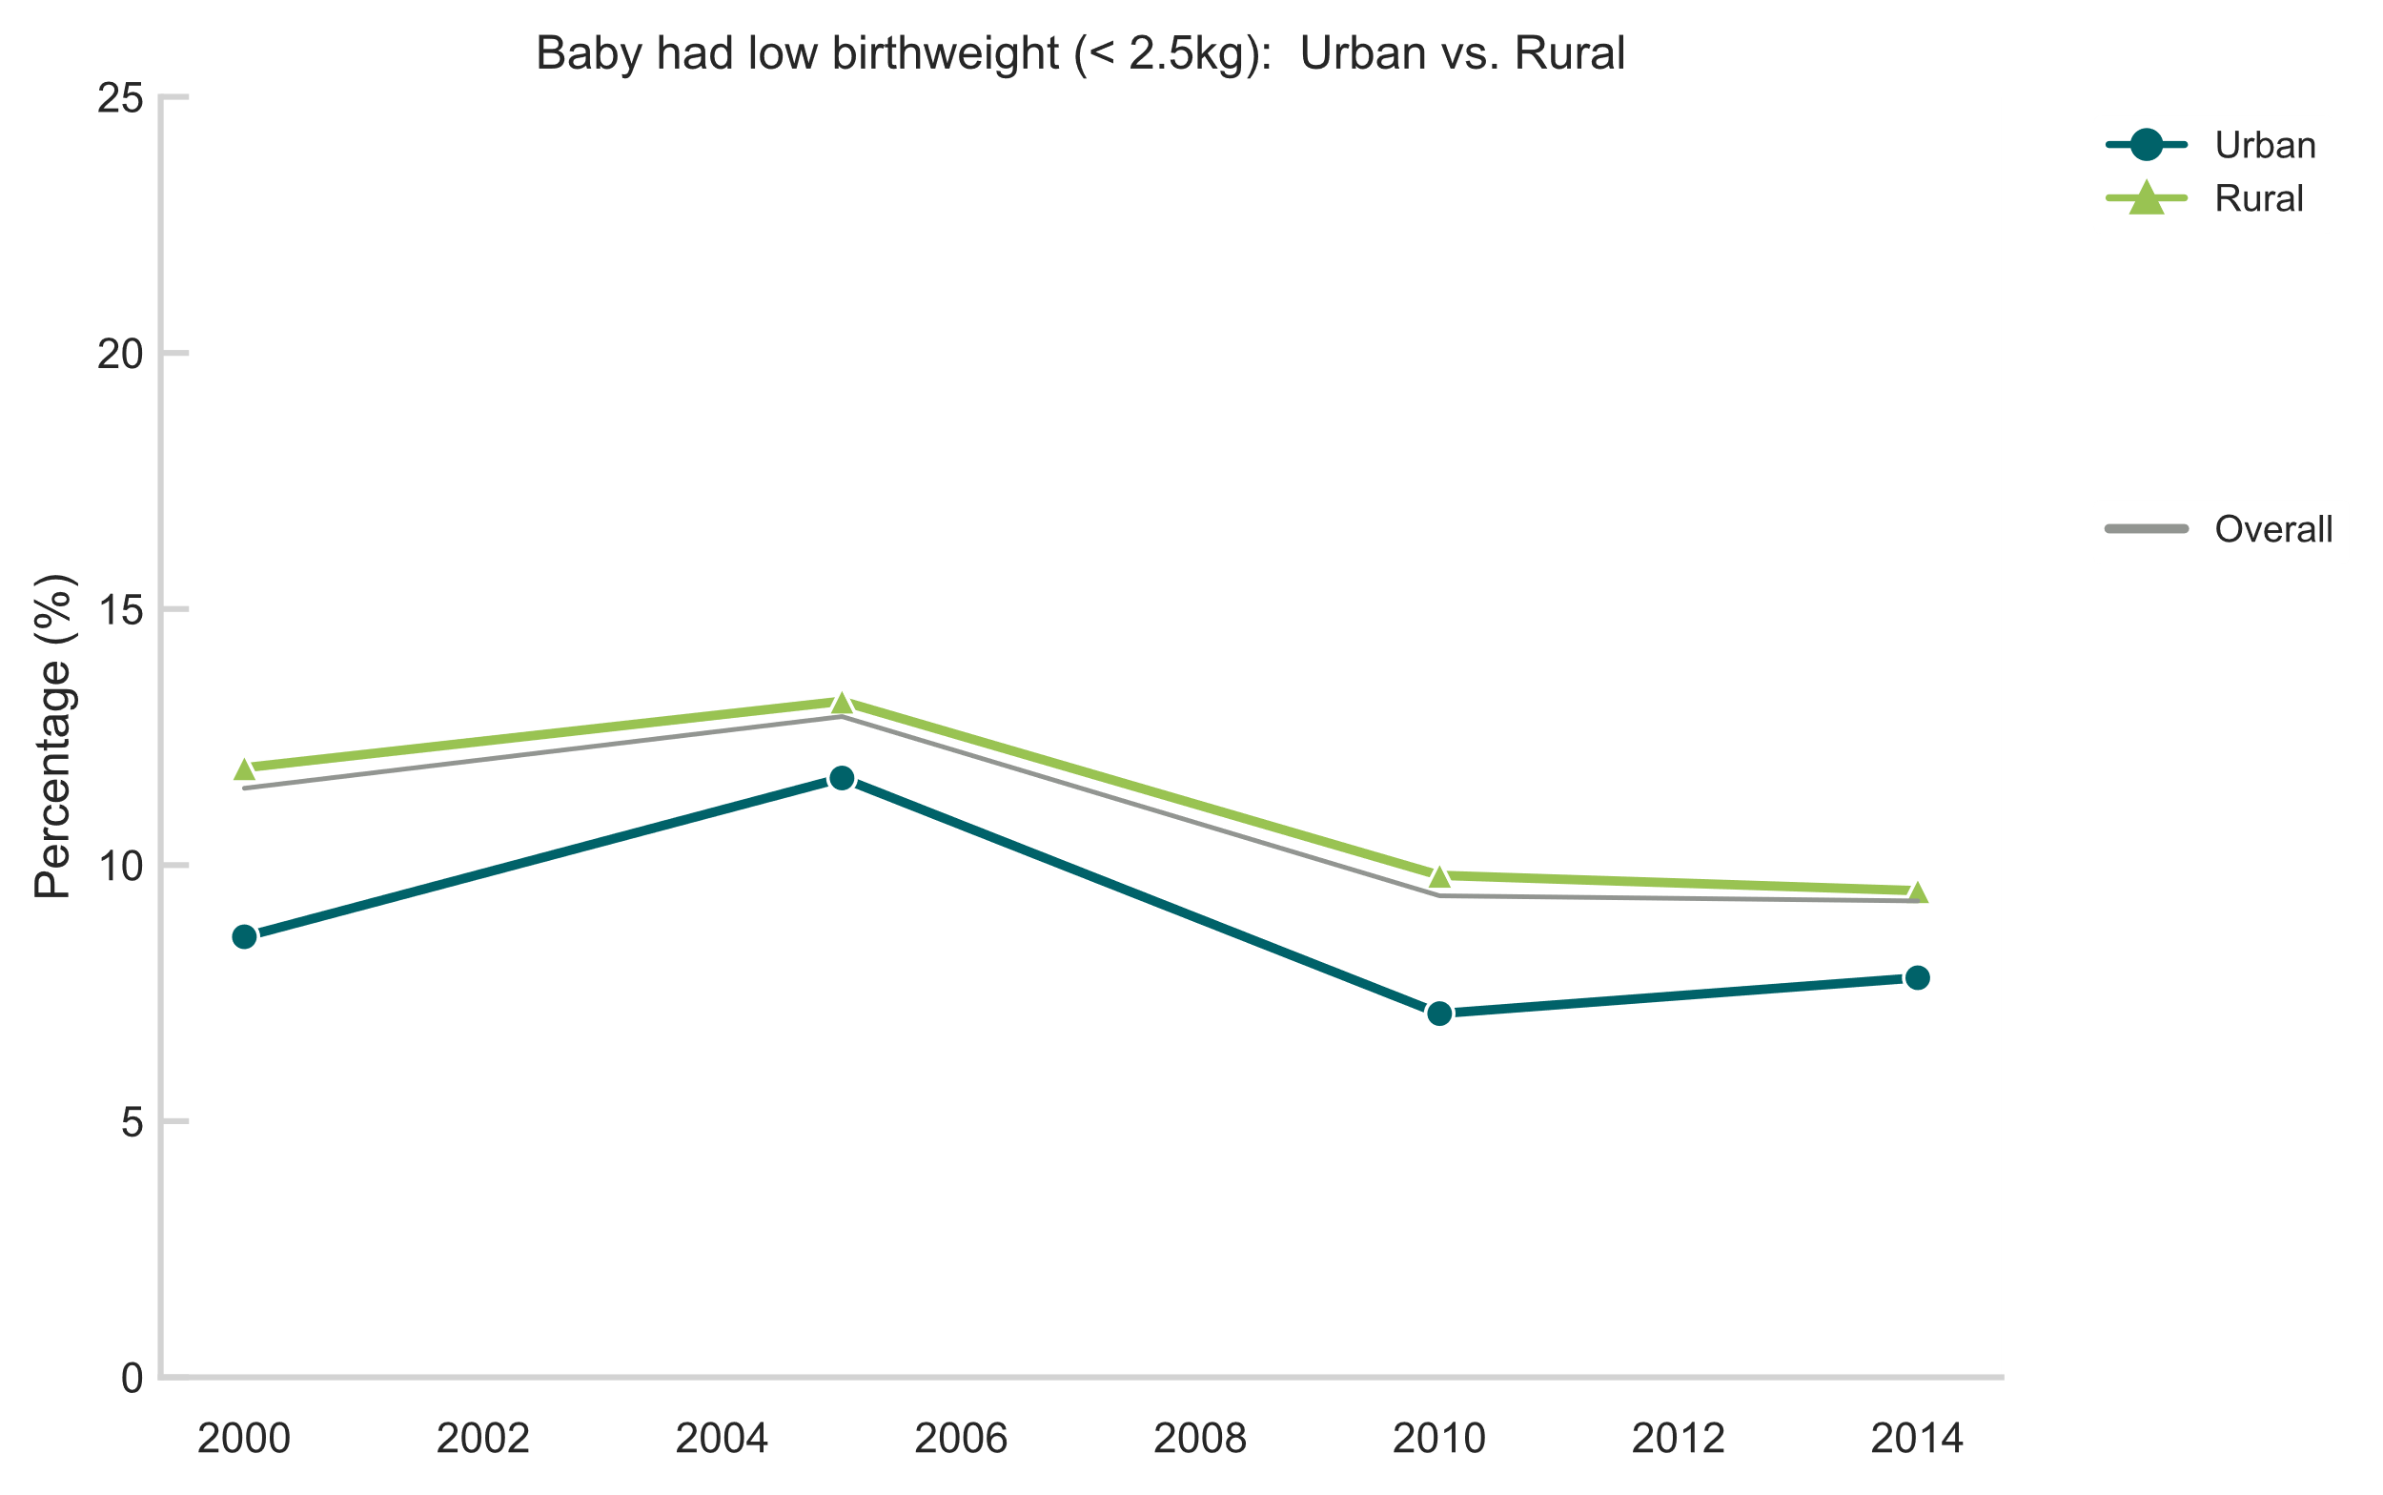
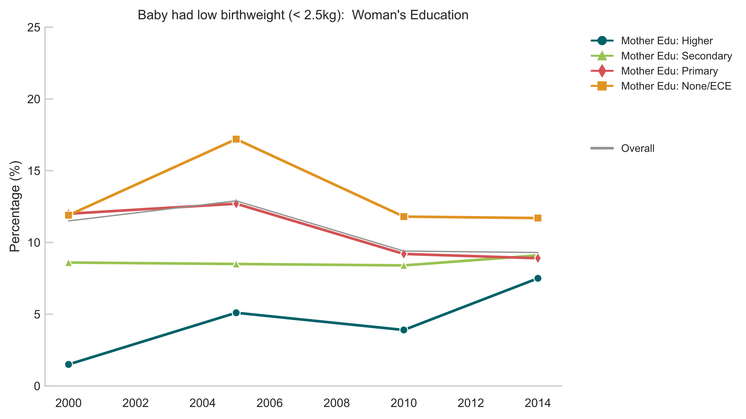
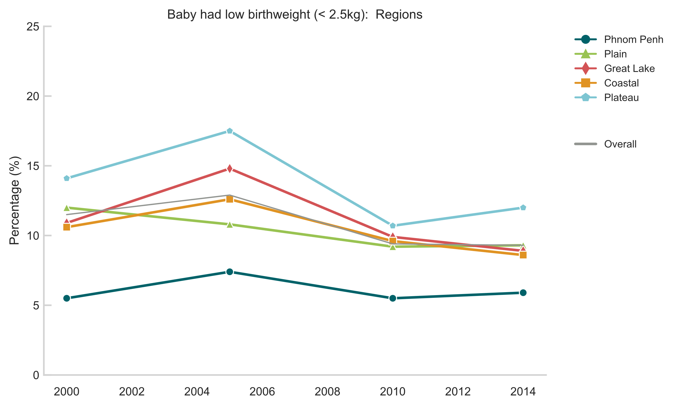
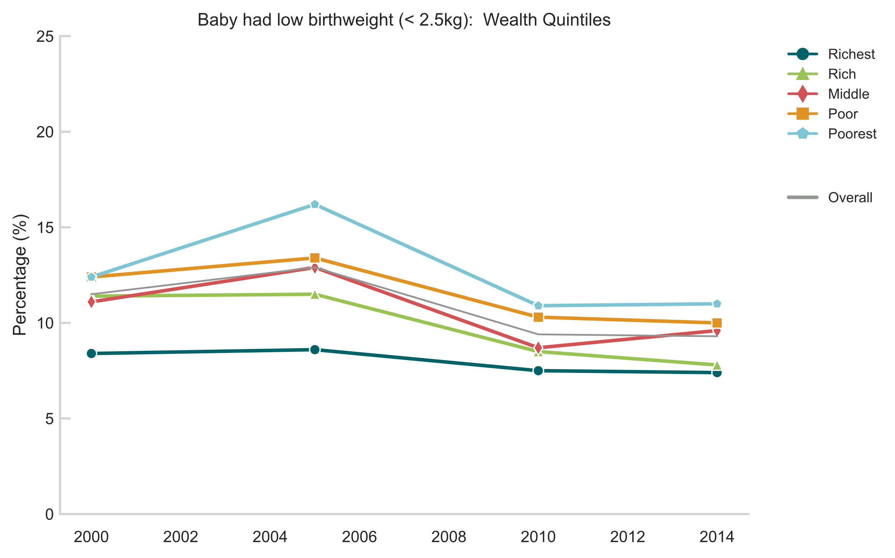
Low birthweight
Less than half of births weighed in 2005 and 2000 surveys making comparison difficult; a more meaningful trend will be available with 2021 data
Virtually no improvement between 2010 and 2014
Definition: Percentage of most recent live births within the past two years that weigh less than 2500g

Slide 10
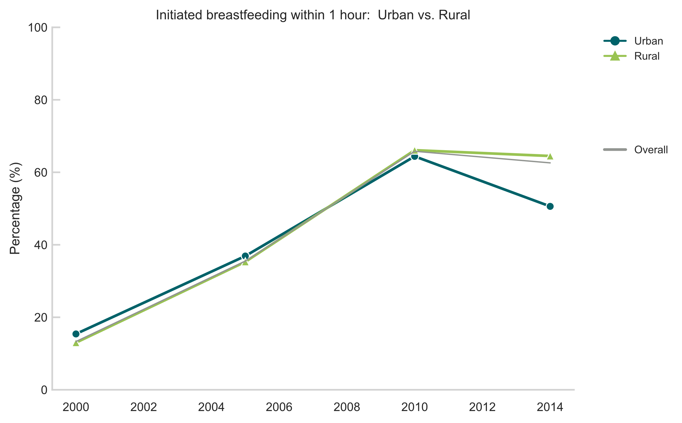
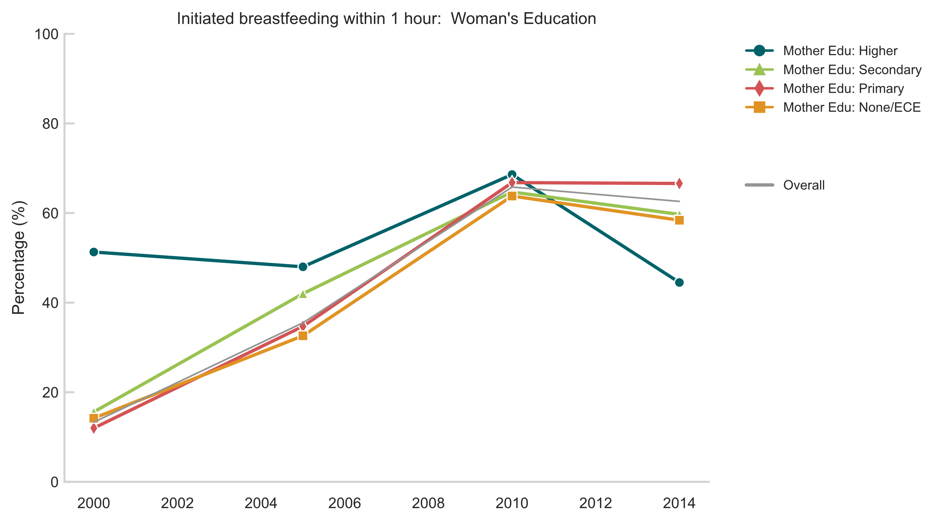
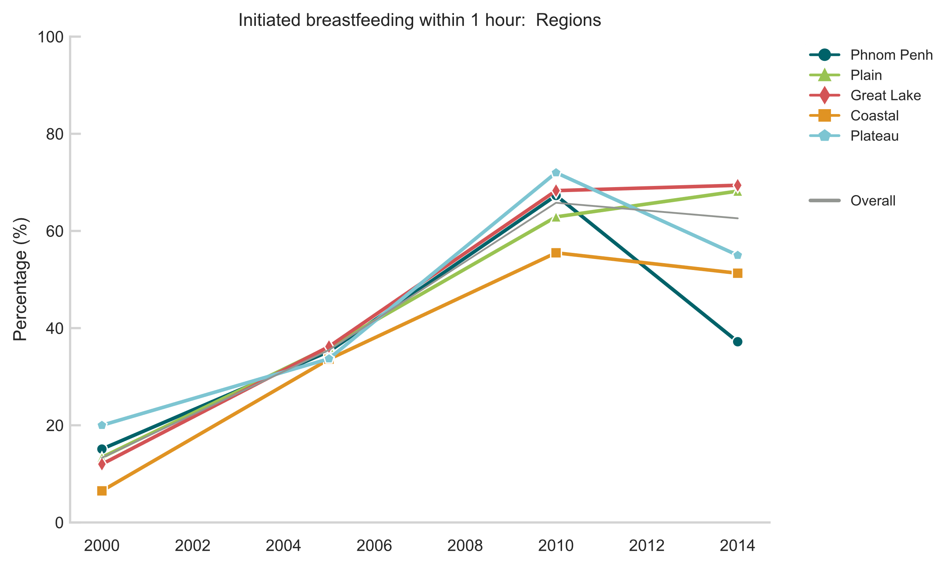
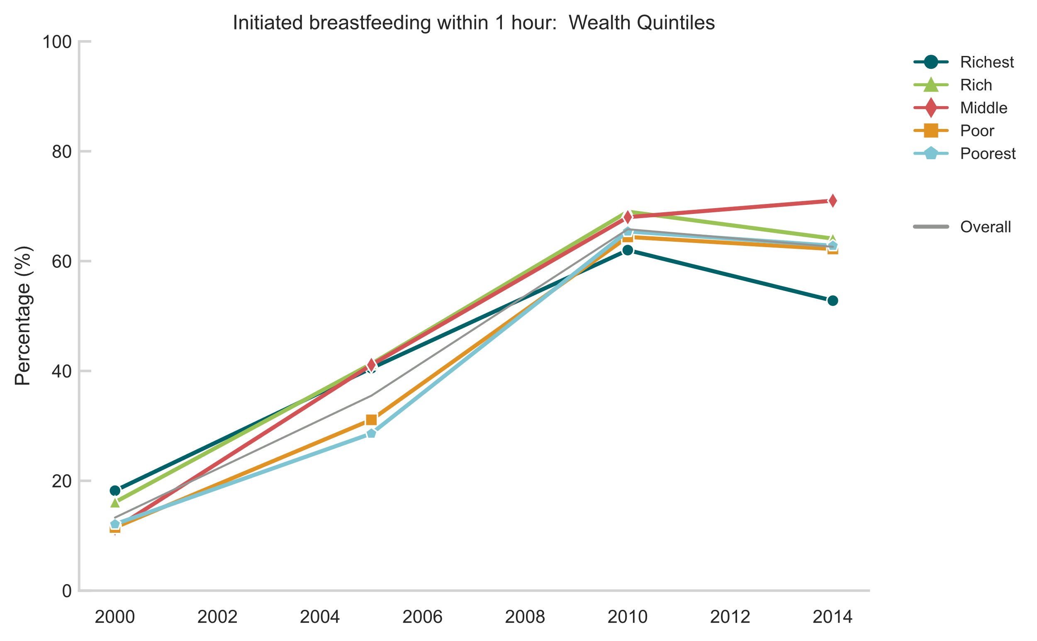
Early initiation of breastfeeding
Strong gains from 2000 to 2010 followed by plateauing due to dropoff among women from highest socioeconomic backgrounds
Availability of 2021 data to determine if trend was real or just an anomaly
If real, suggests potential connection with medicalization of birth, caesarean, and formula feeding
Definition: Percentage of (most recent) children born within the past two years who were put to the breast within one hour of birth.

Slide 11
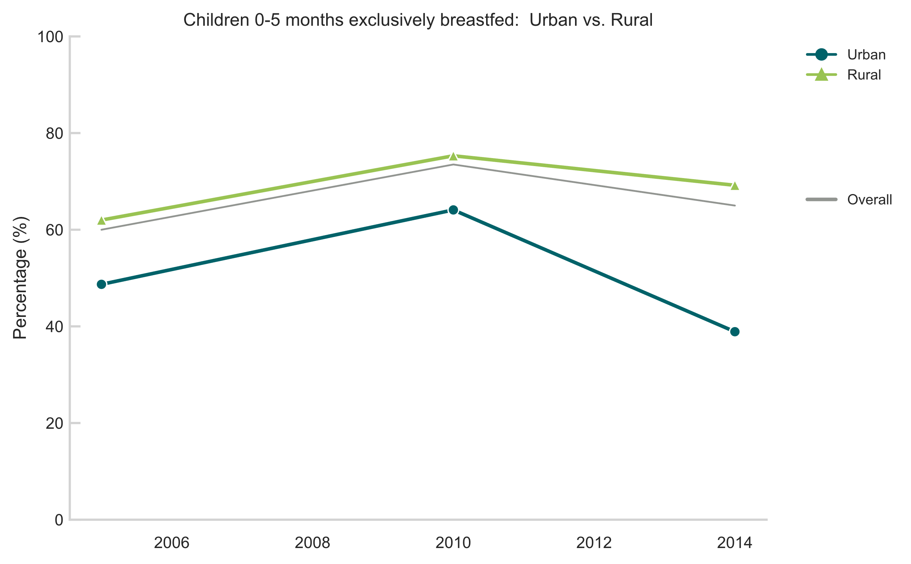
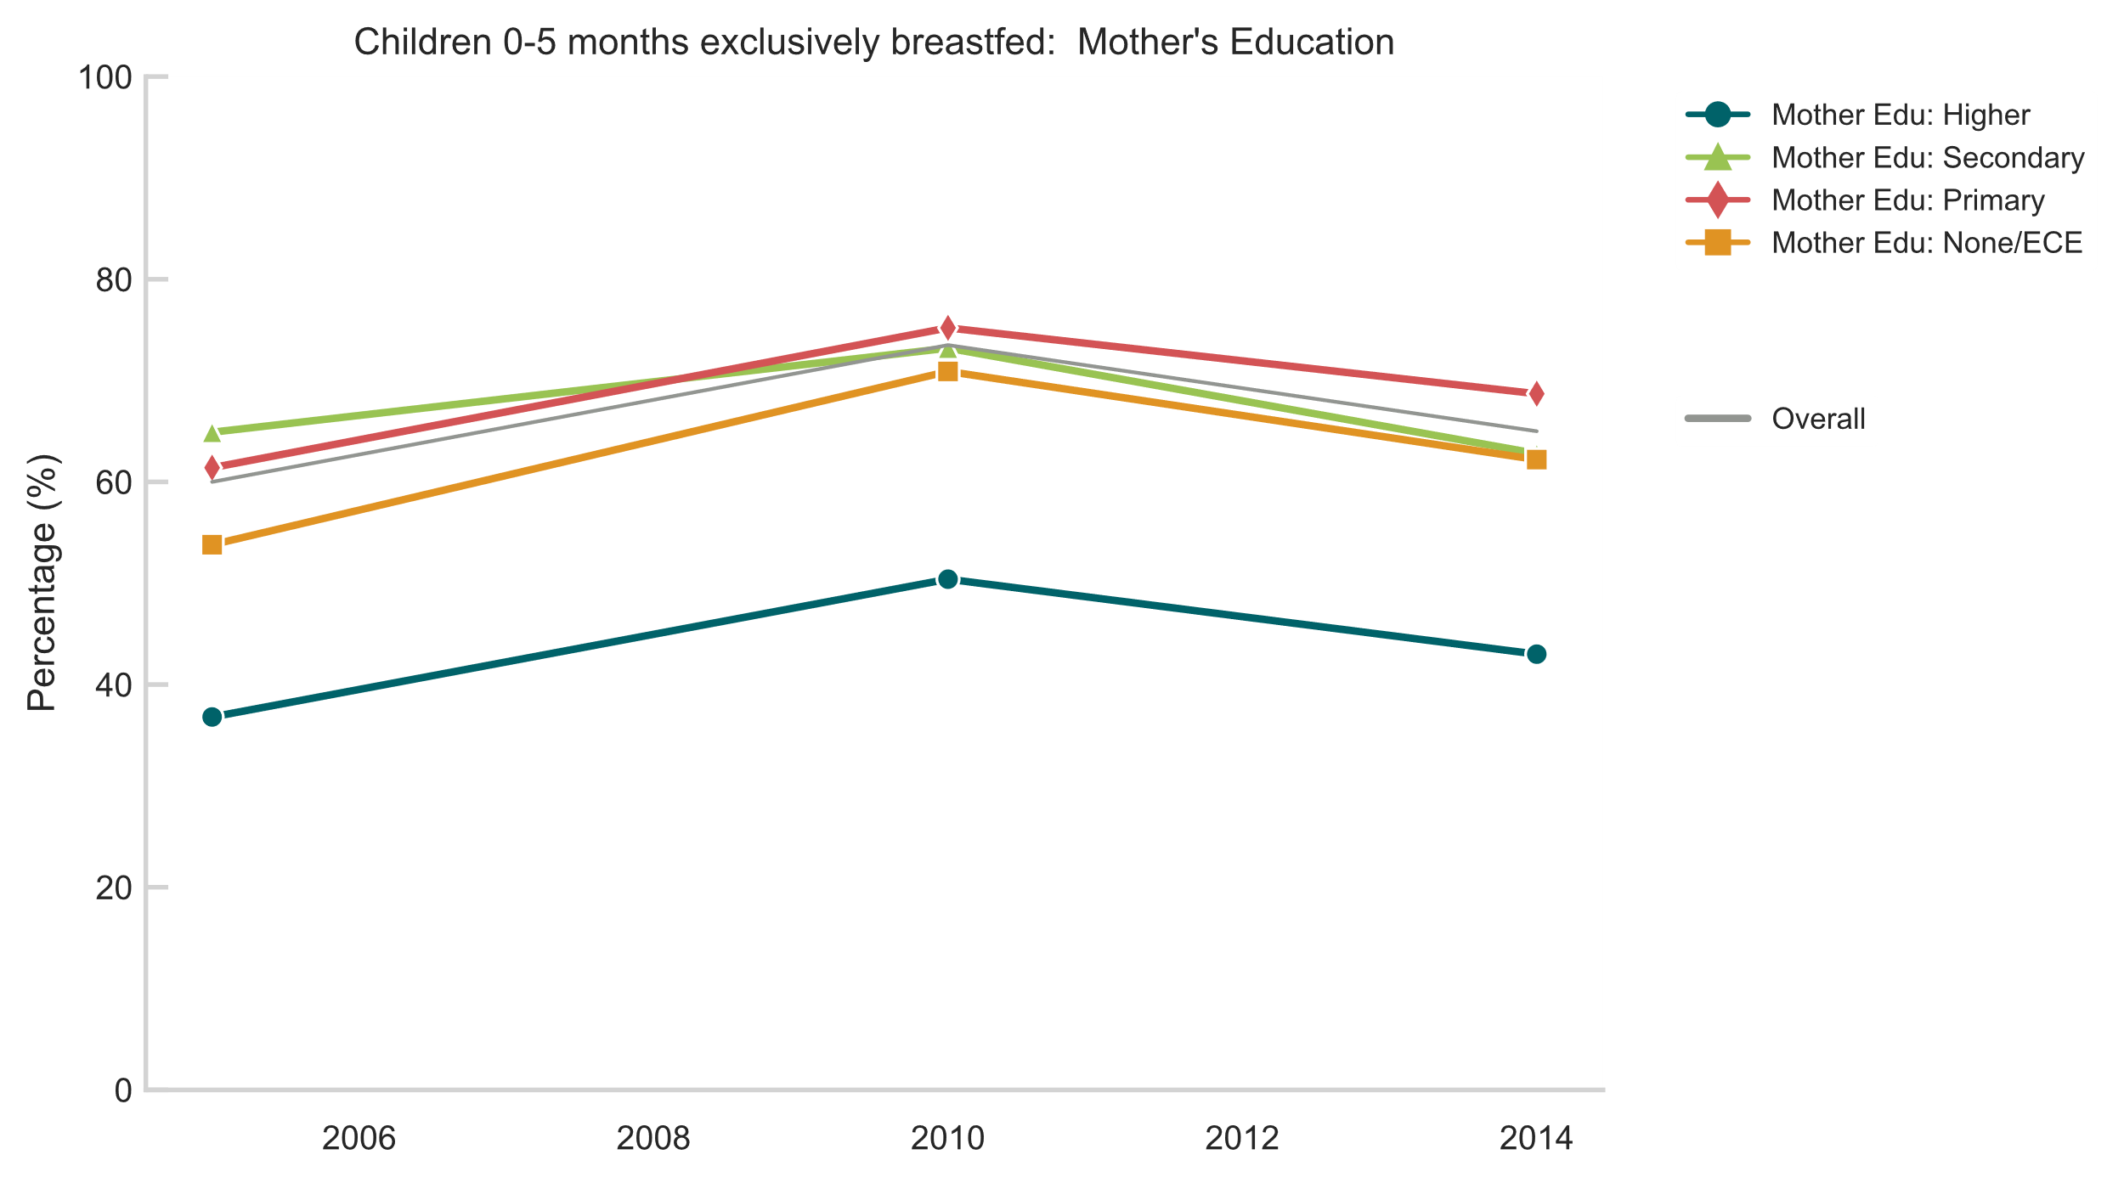
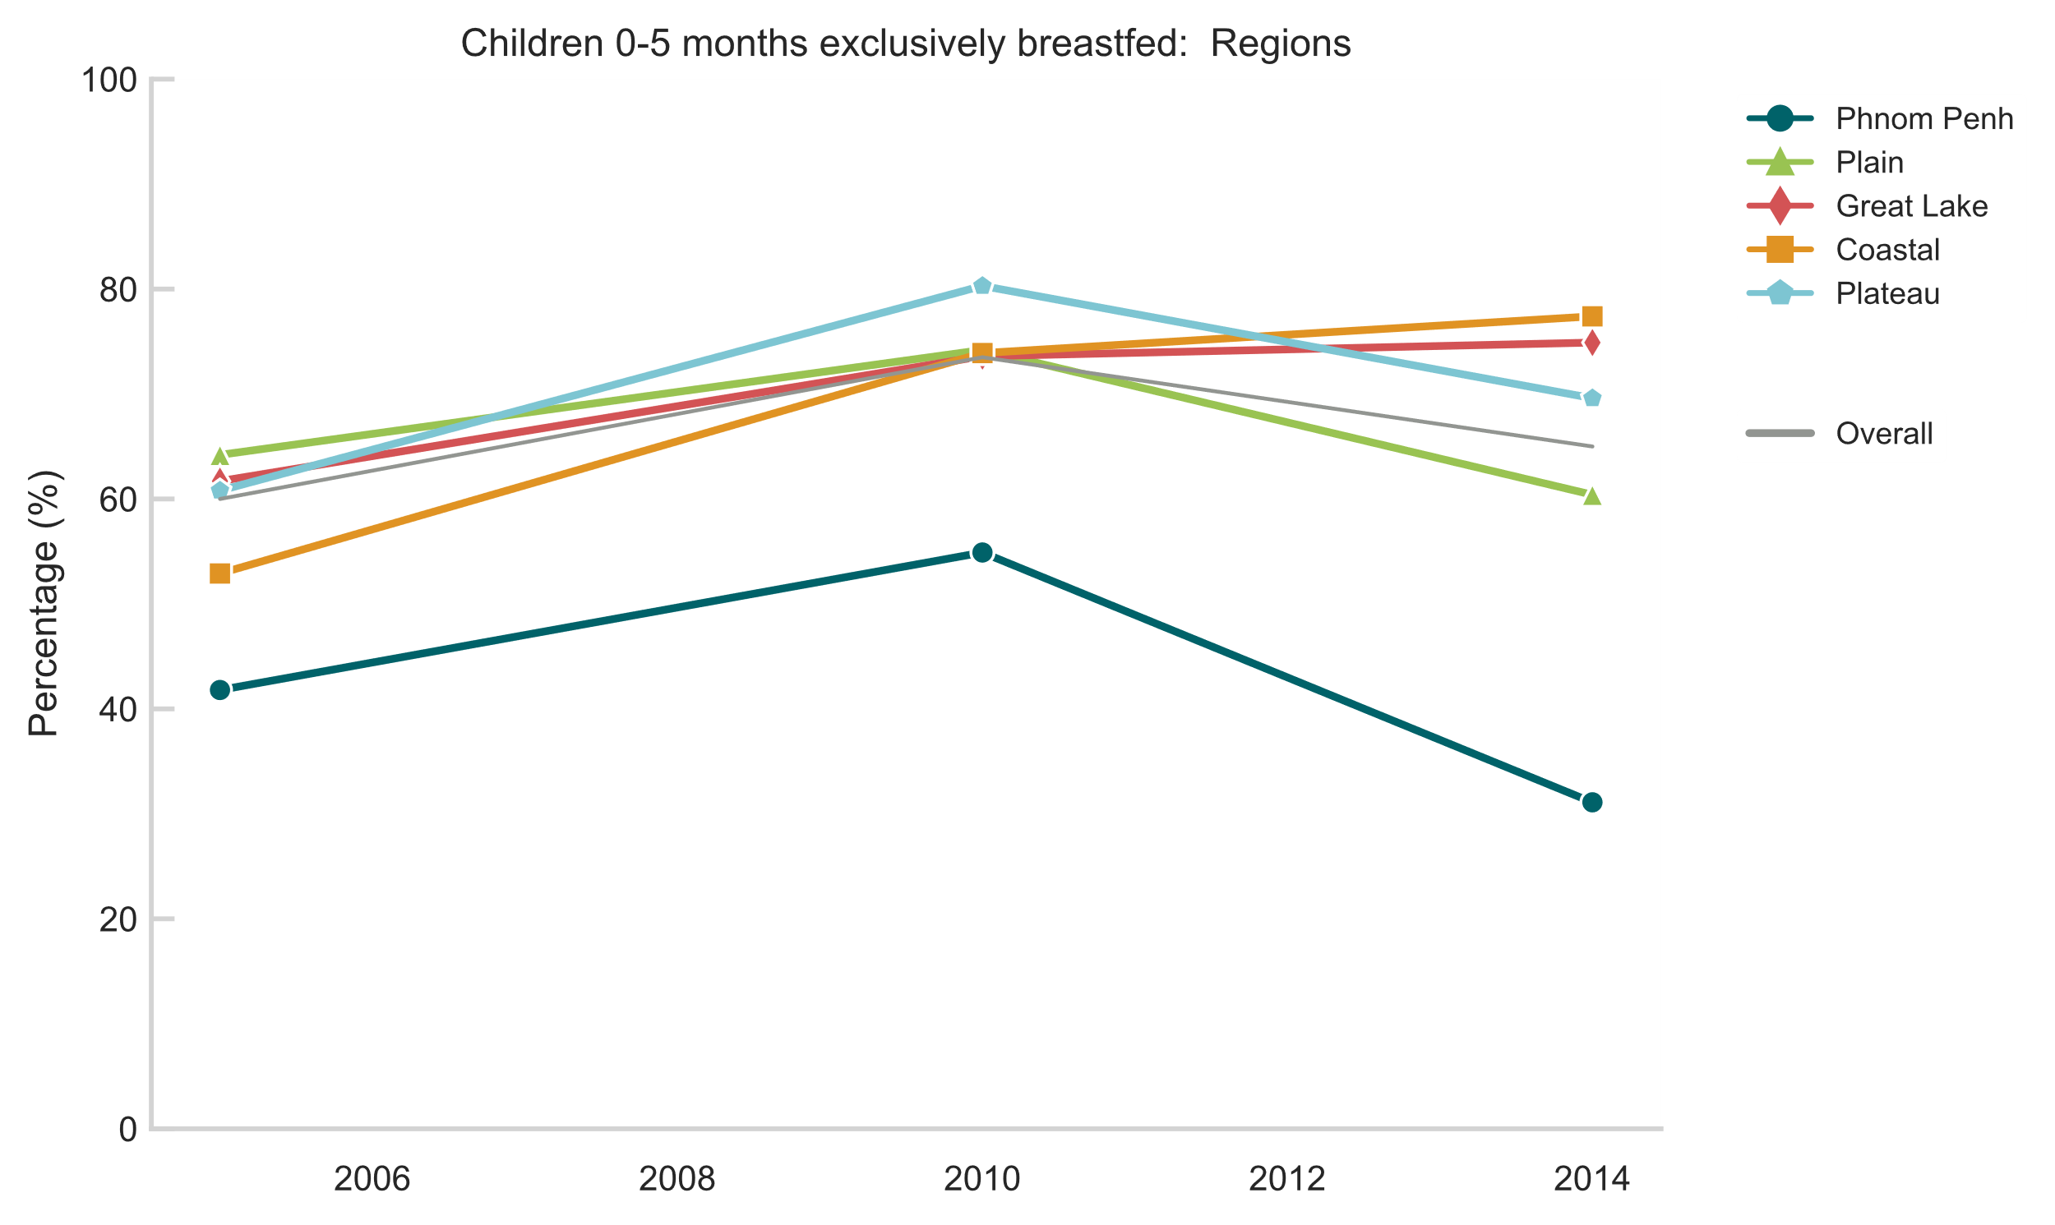
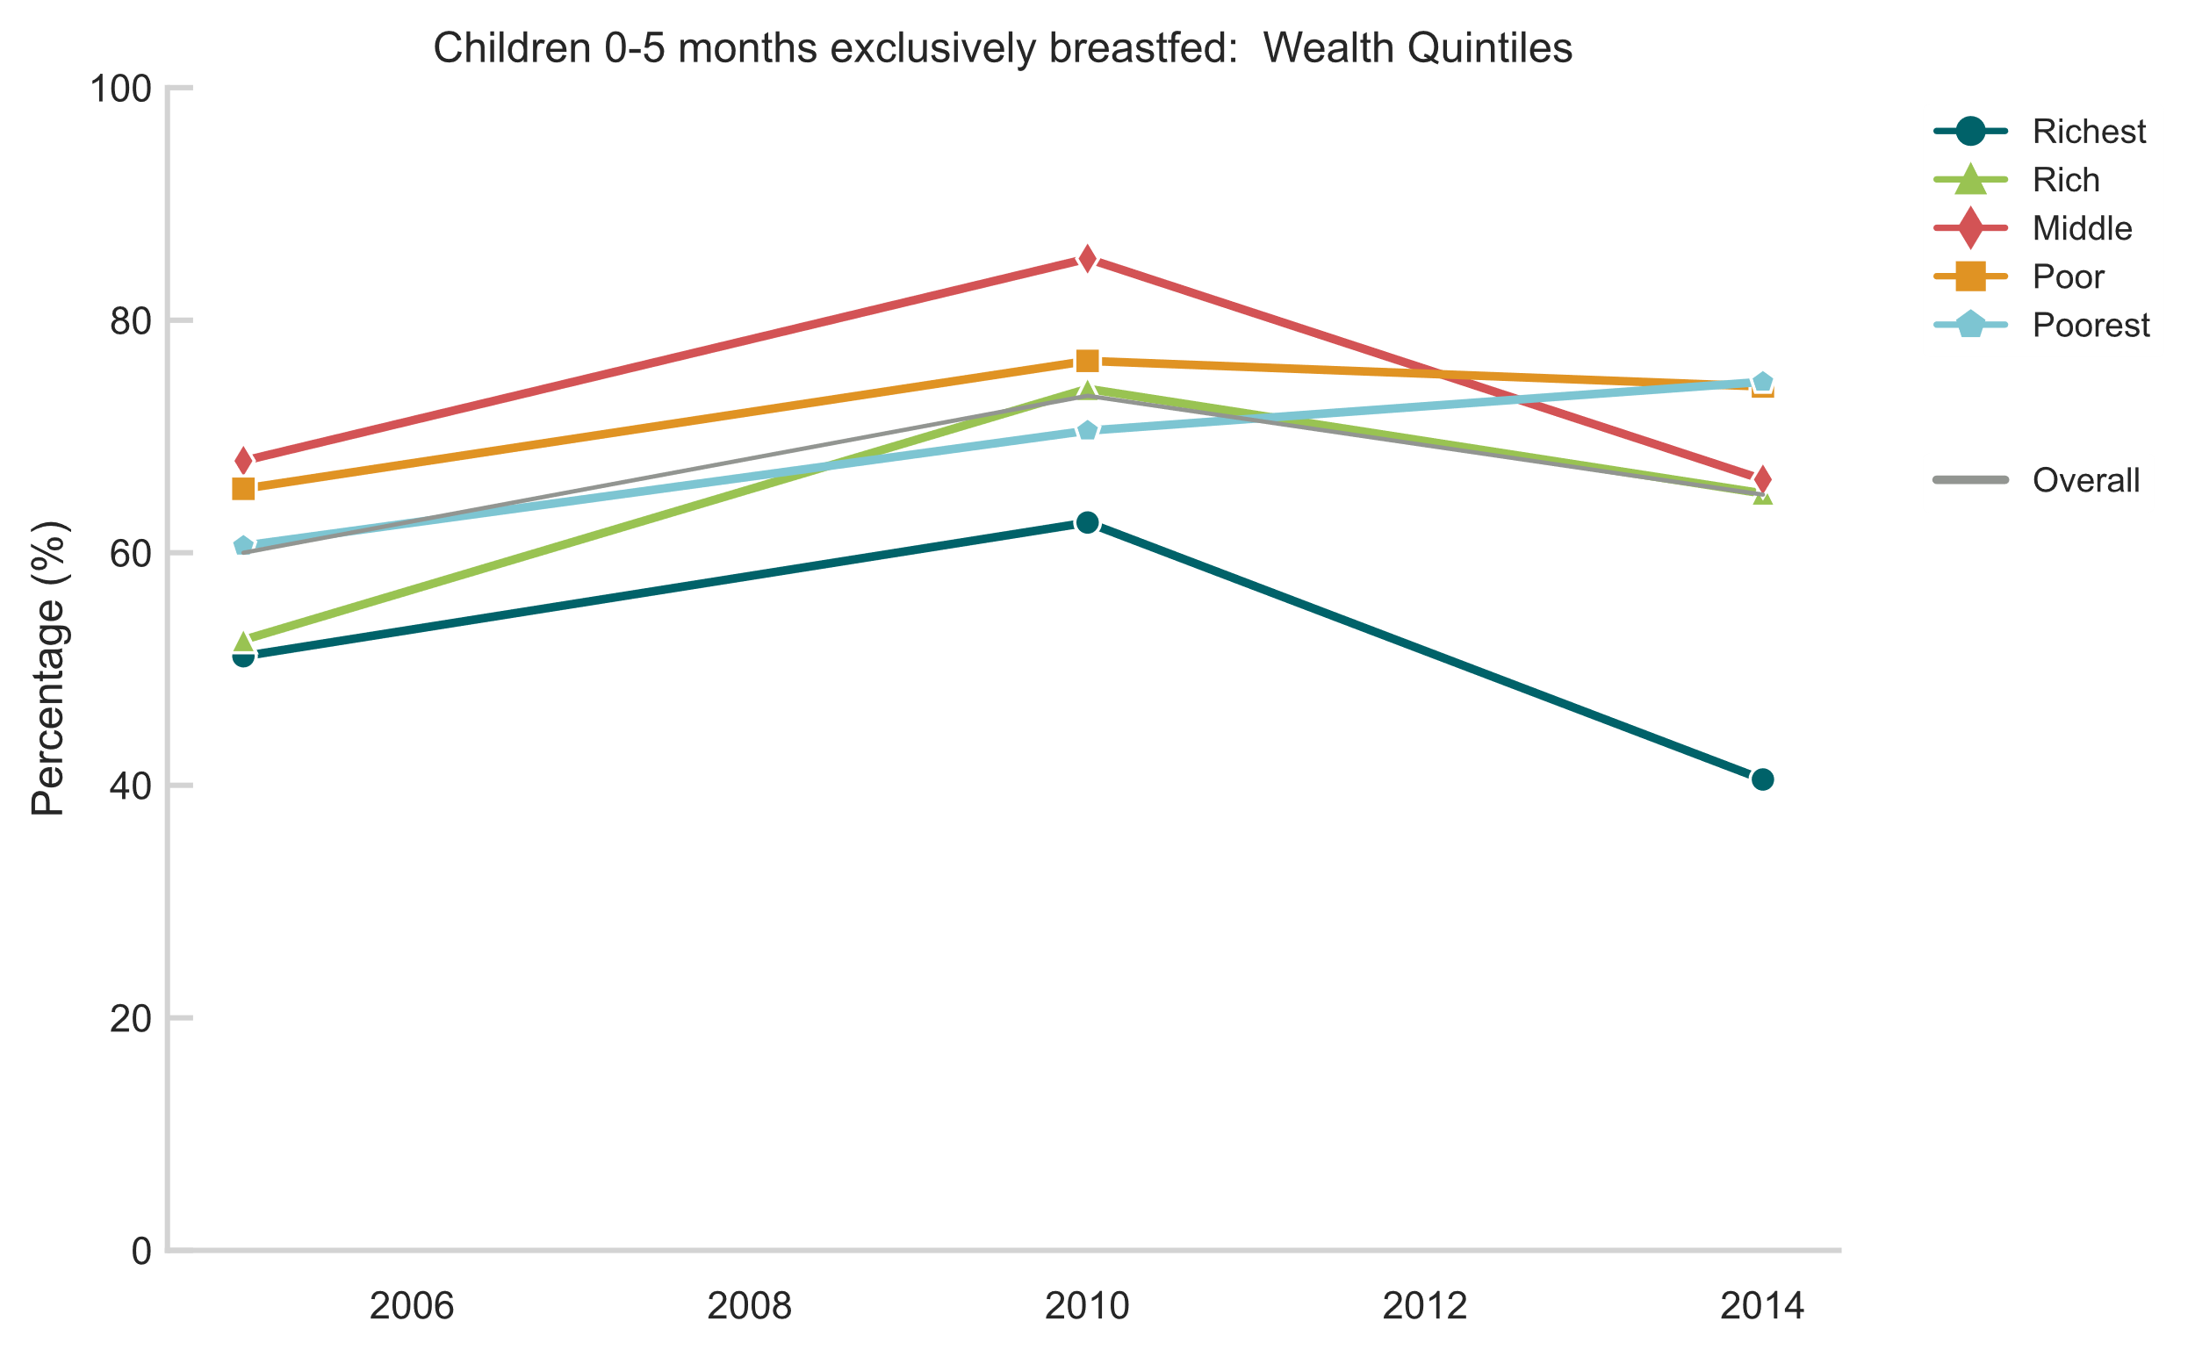
Exclusive Breastfeeding (0-5 mos)
Significant widening of equity gaps within urban/rural and according to wealth owing to the reversal of trend among higher SES women following 2010
Trend is more similar to Viet Nam with deterioration as opposed to continued improvement for all groups
Definition: Percentage of infants 0–5 months of age who were fed exclusively with breast milk during the previous day.

Slide 12
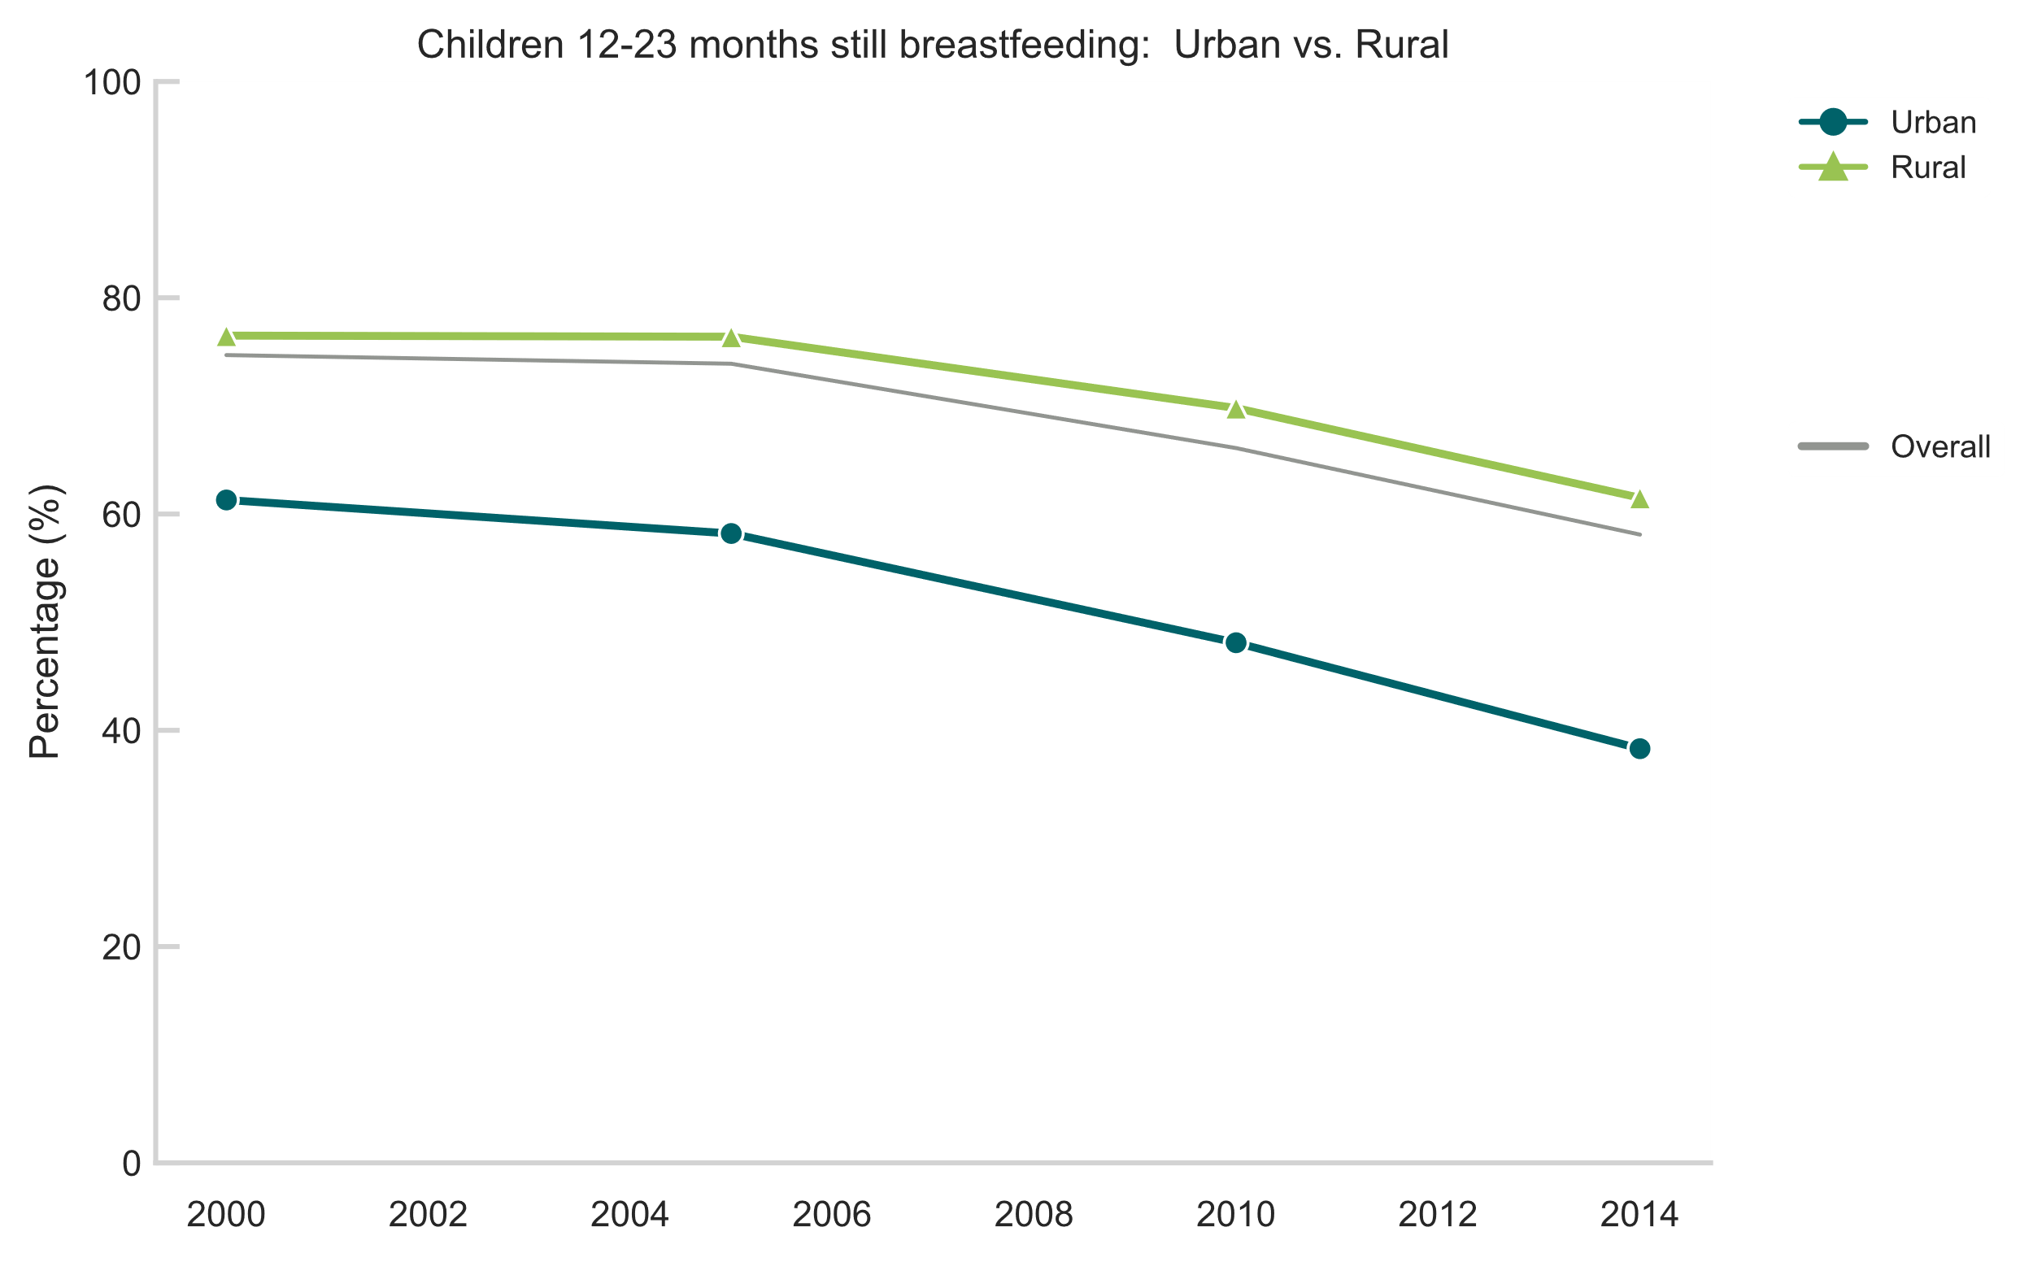
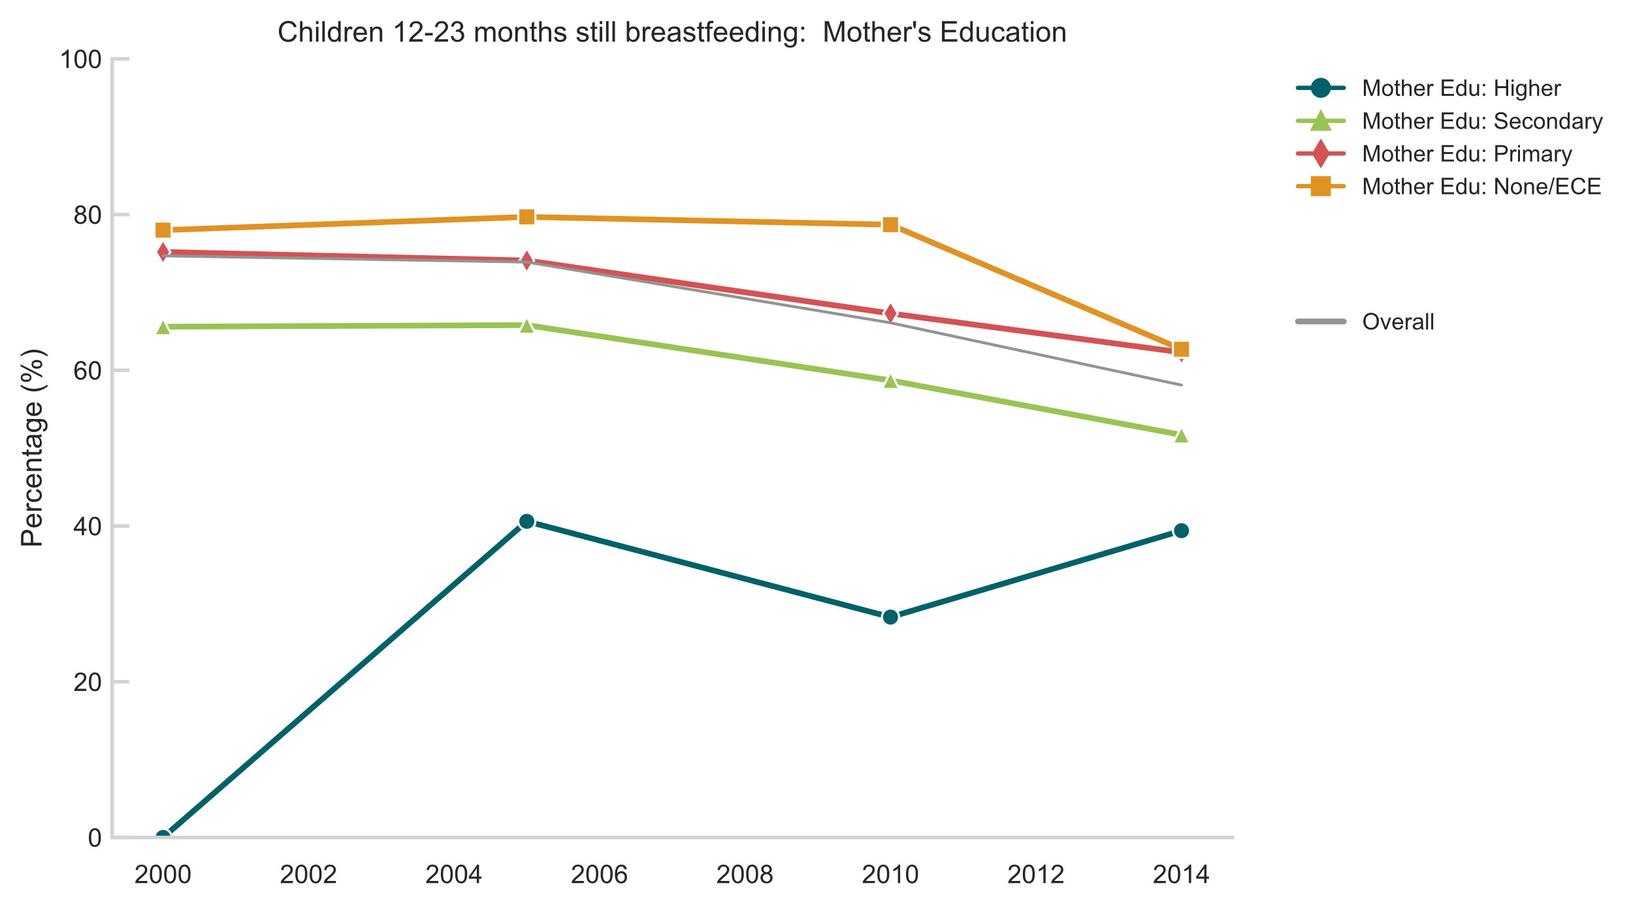
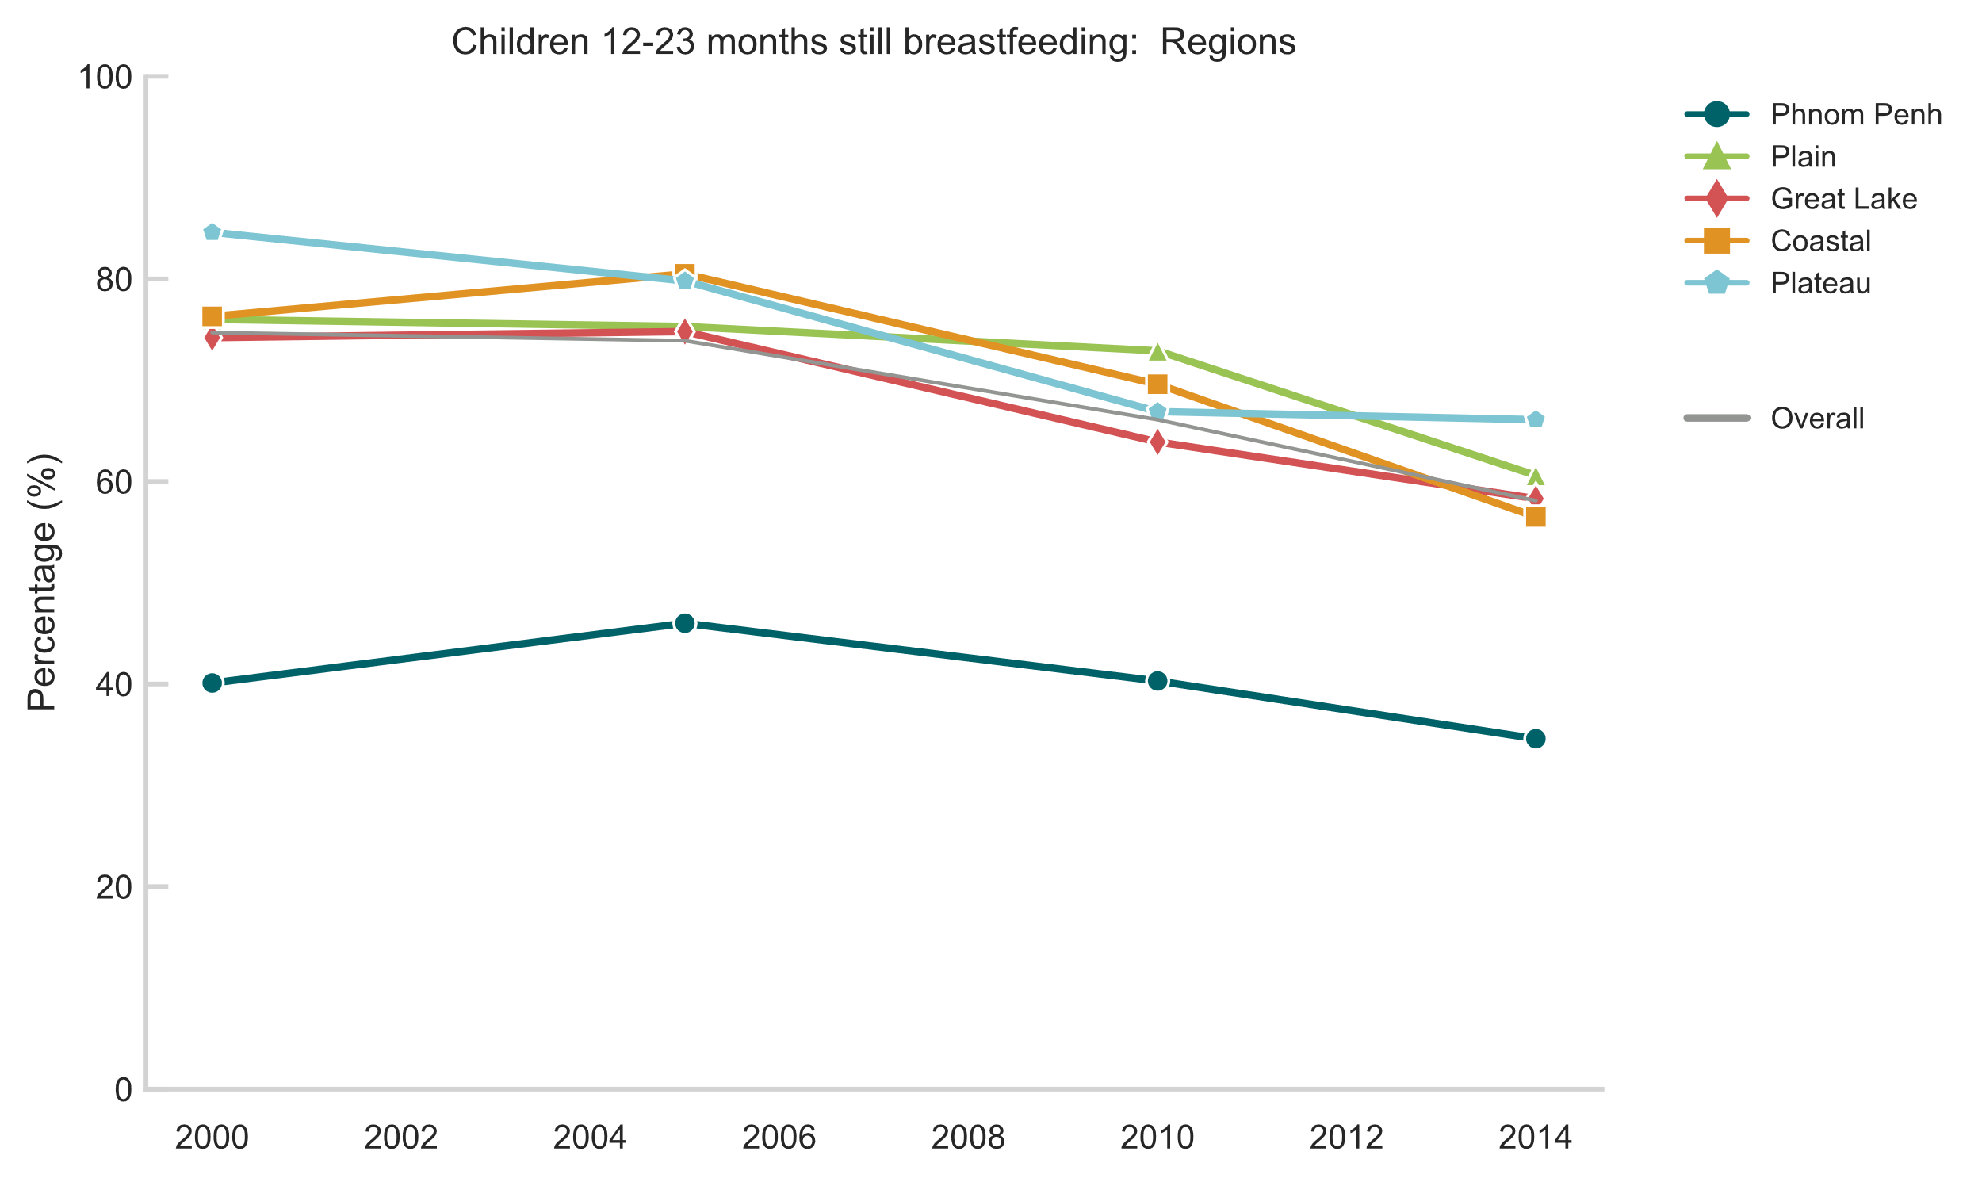
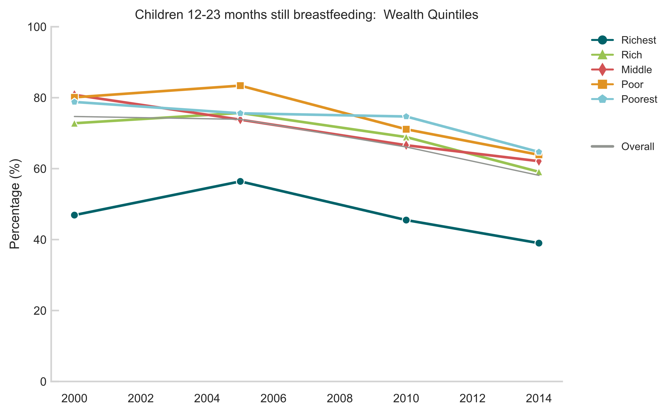
Continued breastfeeding (12-23 mos)
Similar to Lao PDR, large declines in breastfeeding rates at 1 year though from a higher base (75% down to 58%)
Equity gaps did not narrow for any subgroup over the review period
Definition: Percentage of children 12–23 months of age who were fed breast milk during the previous day.
Notes:
Remains most comprehensive indicator (time coverage & comparability) of the child indicators

Slide 13
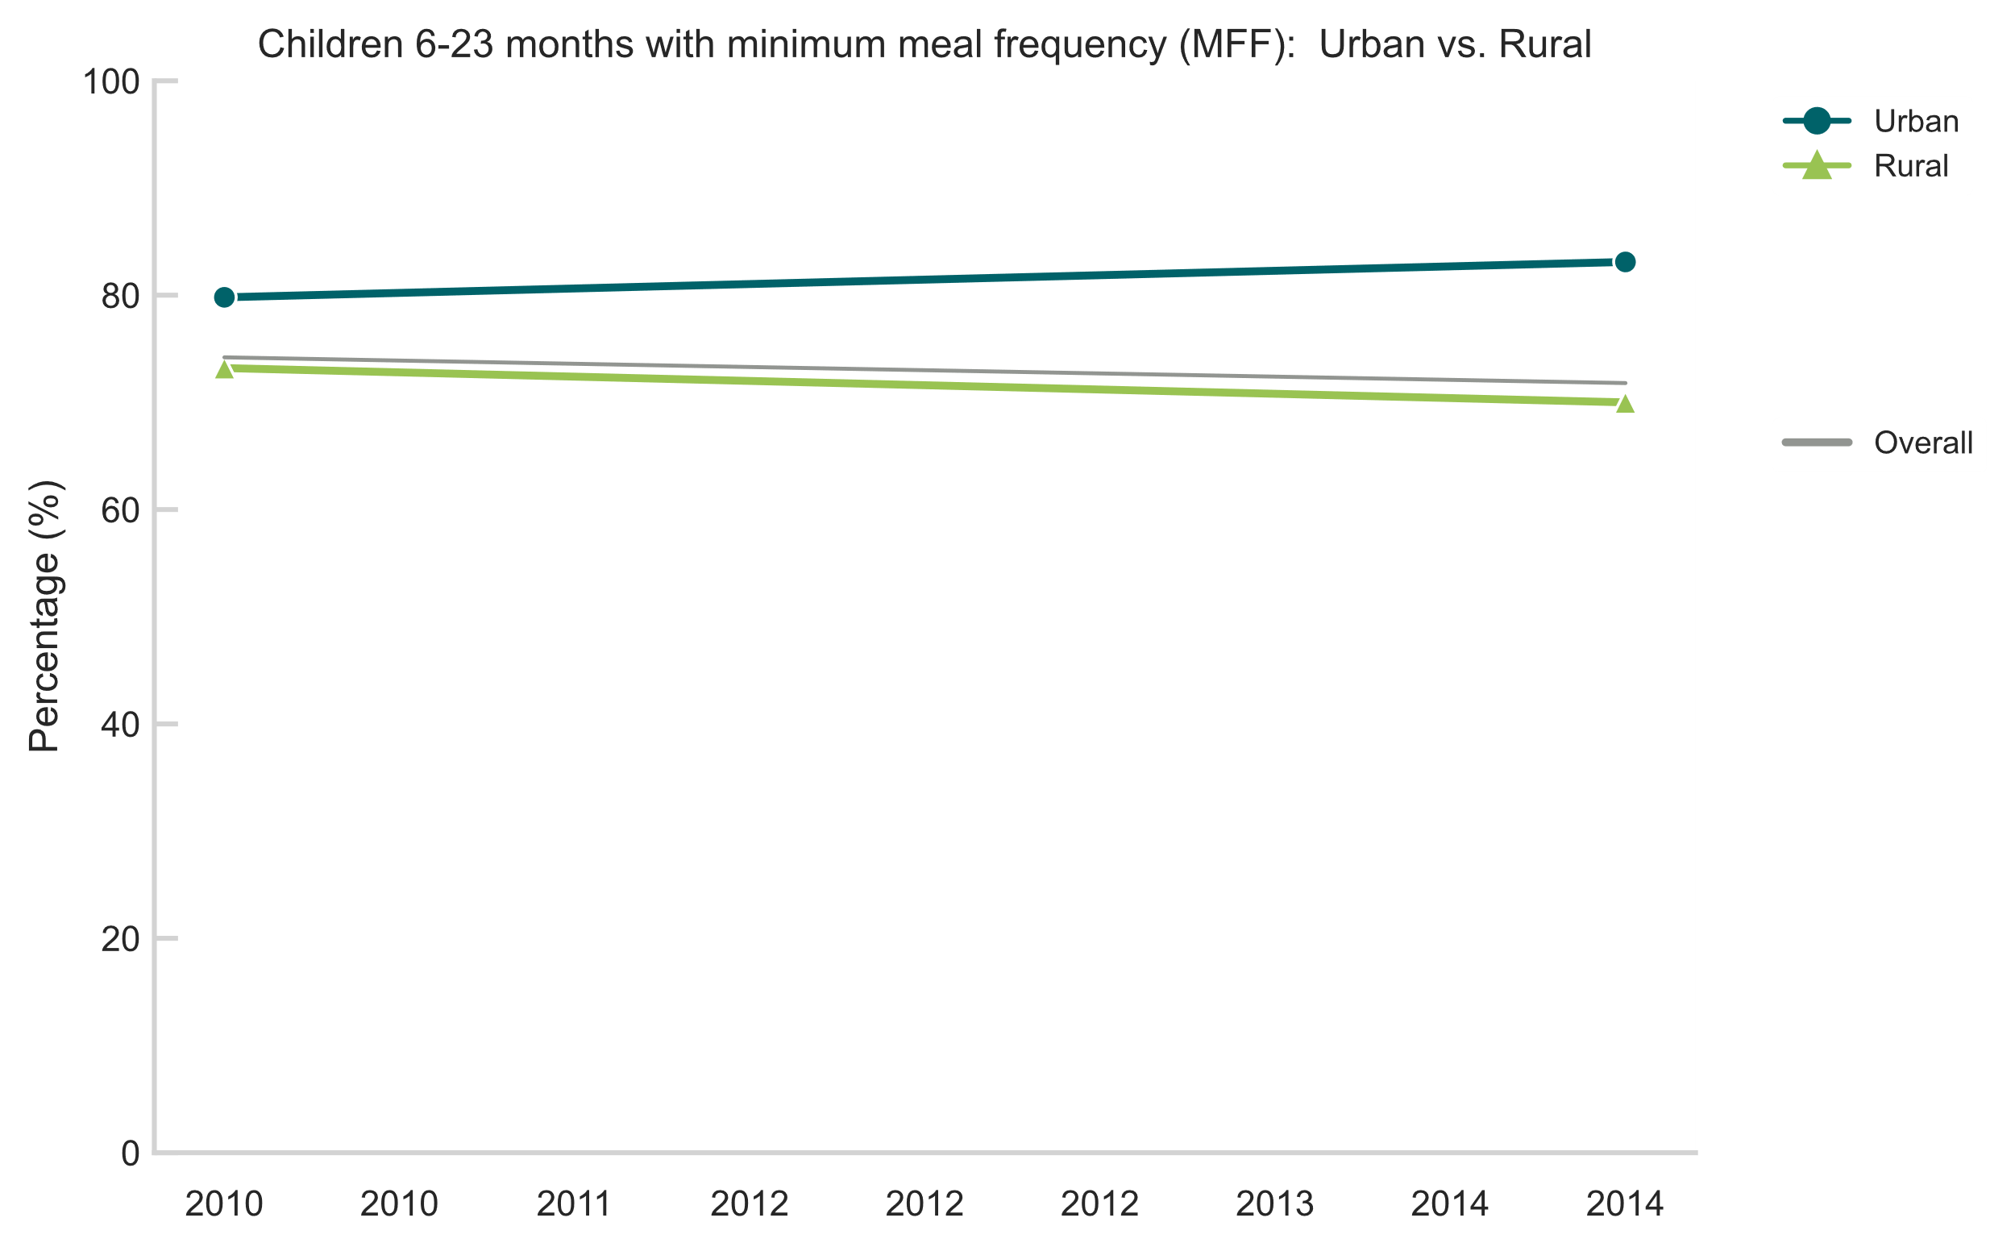
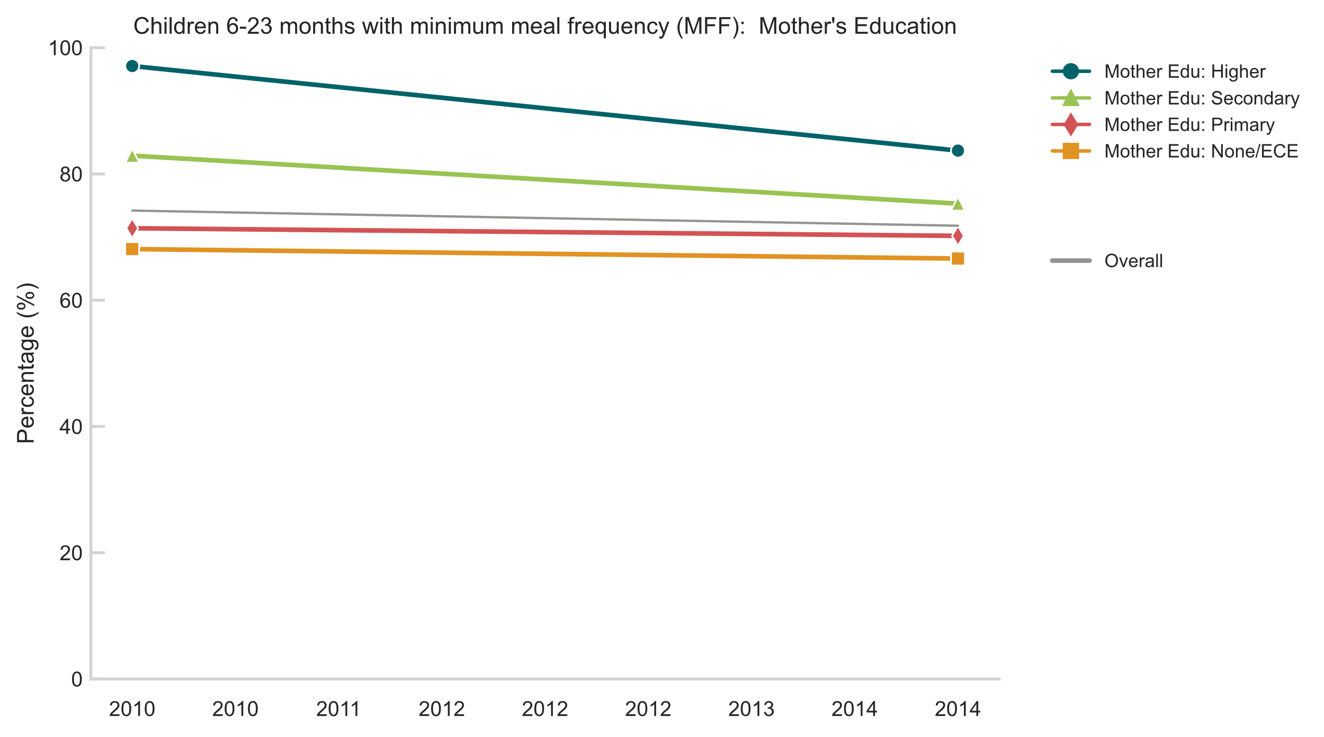
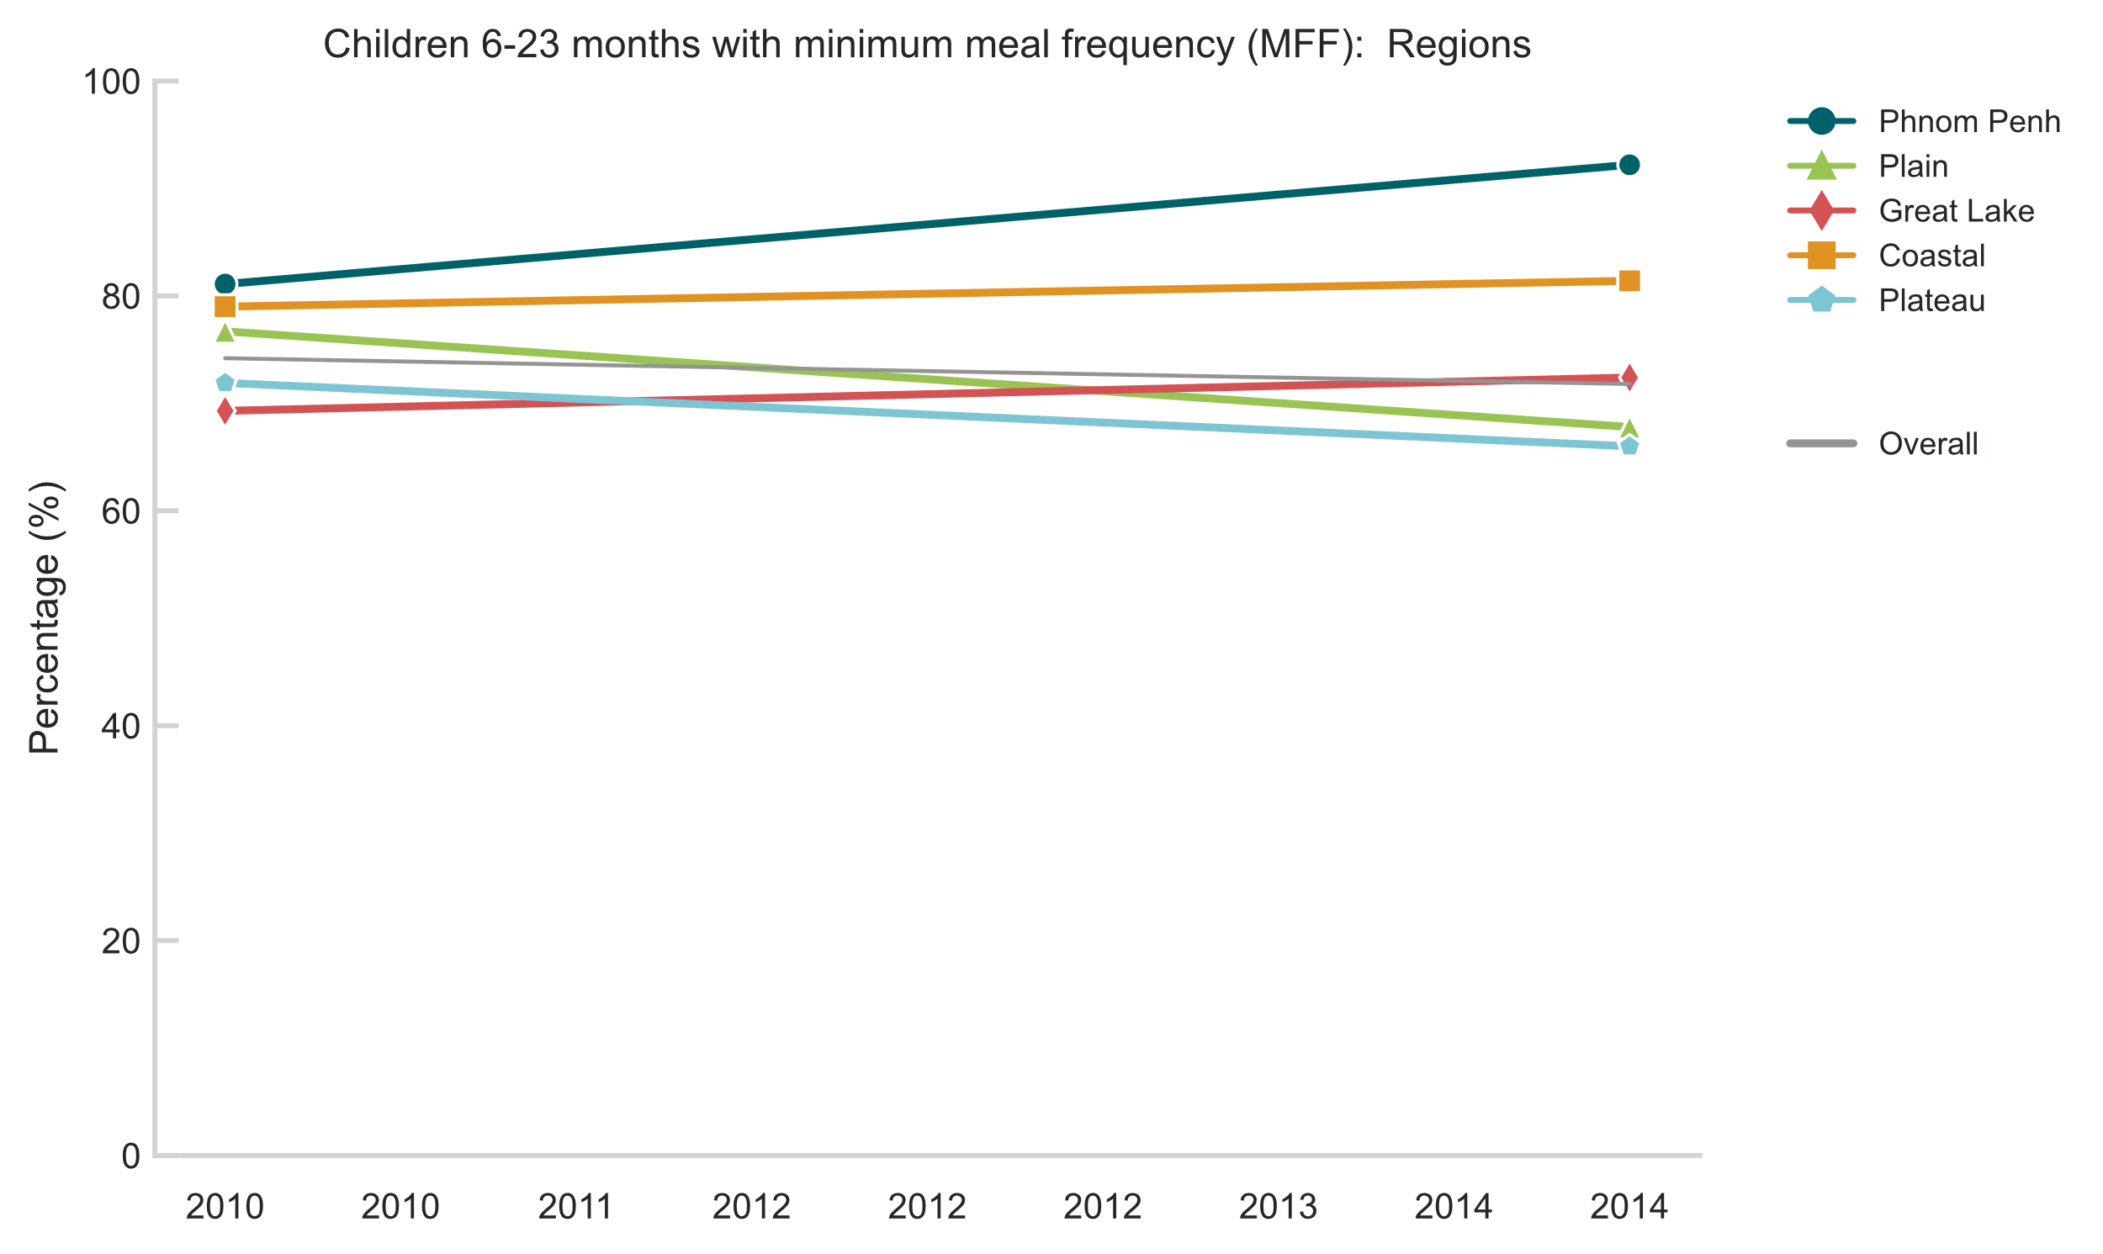
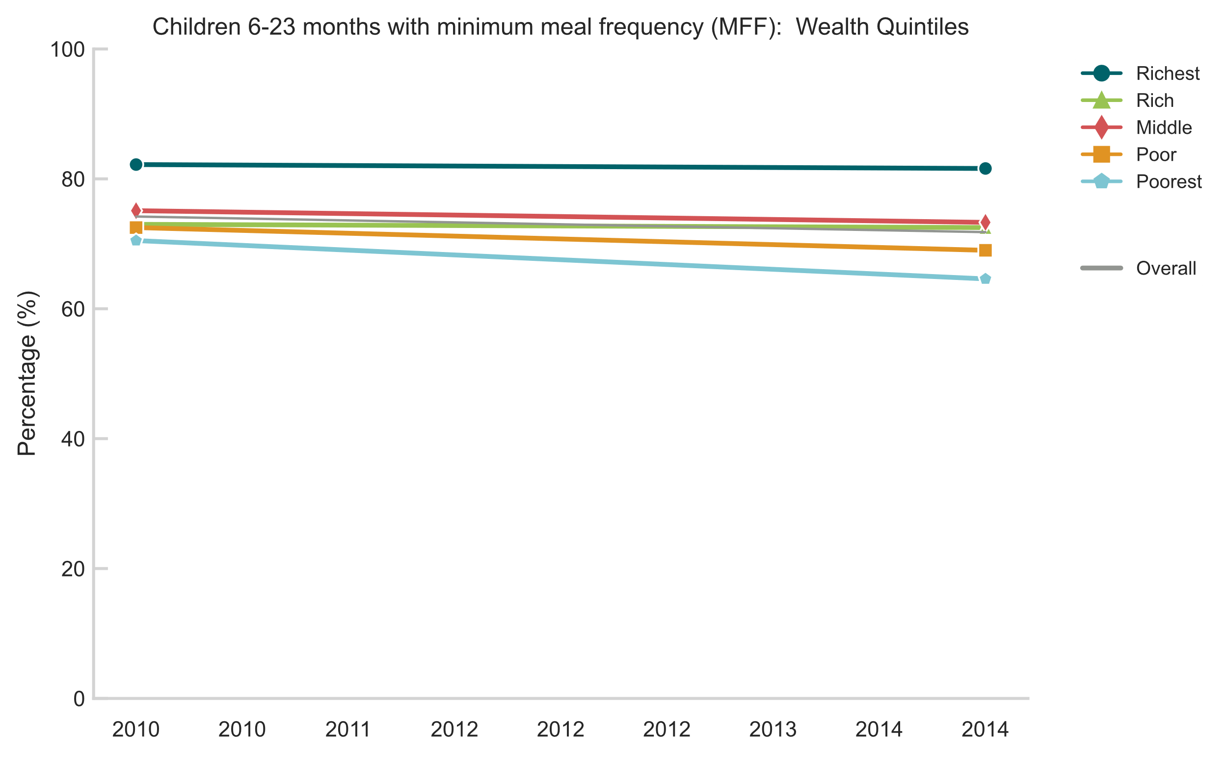
Minimum Meal Frequency (6-23 mos)
In contrast to Lao PDR, no overall improvement between 2010 and 2014
Equity gap for mother’s education significantly narrowed owing to the slight deterioration among better educated women
2021 data will help determine if Cambodia follows trend observed in Viet Nam of deterioration after 2014
Definition: Percentage of children 6–23 months of age who consumed solid, semi-solid or soft foods (but also including milk feeds for non-breastfed children) at least the minimum number of times during the previous day.

Slide 14
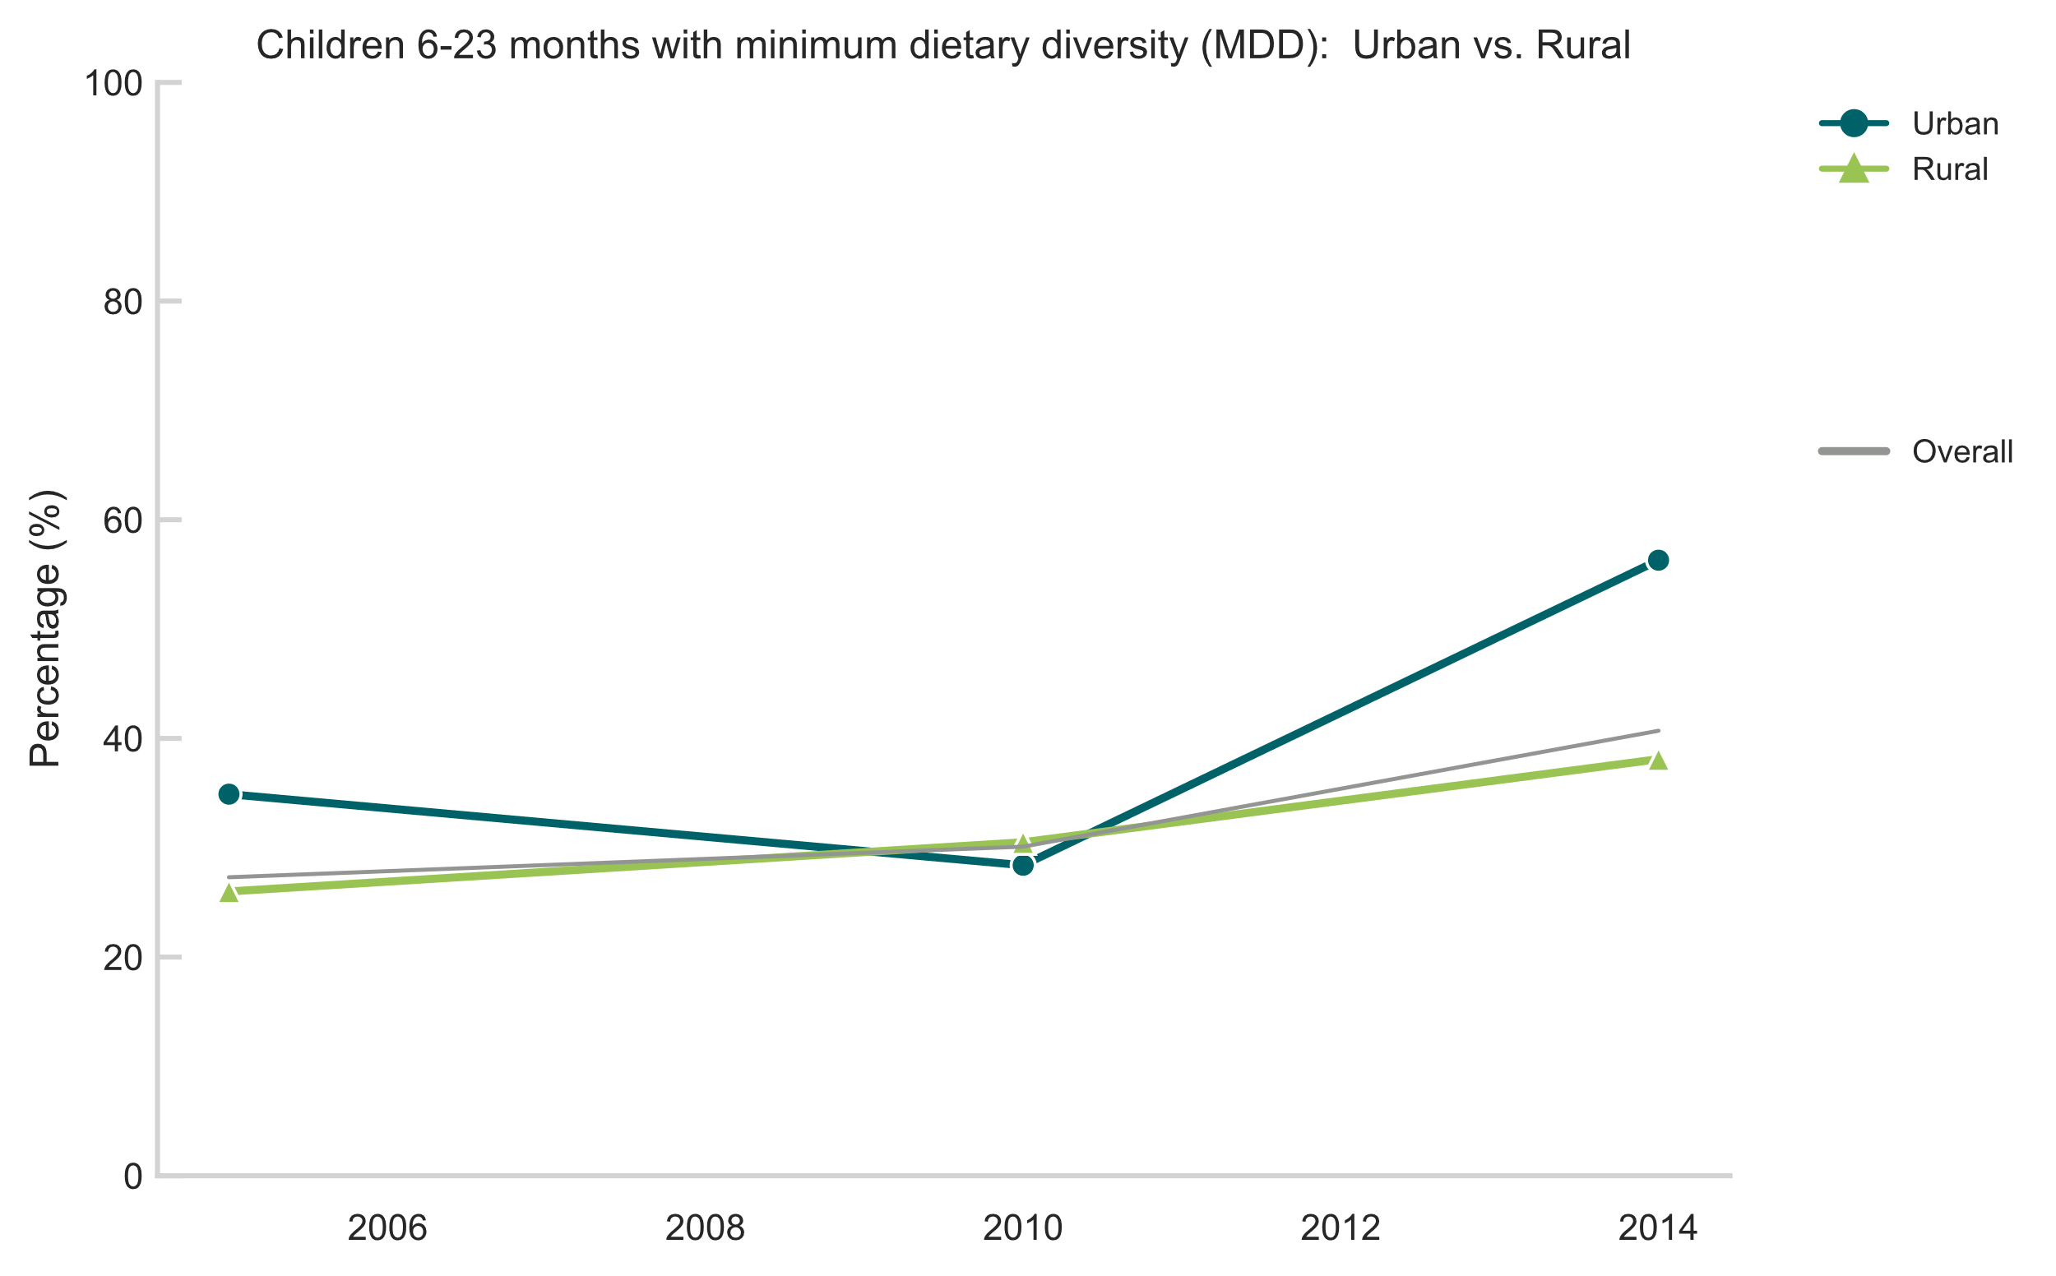
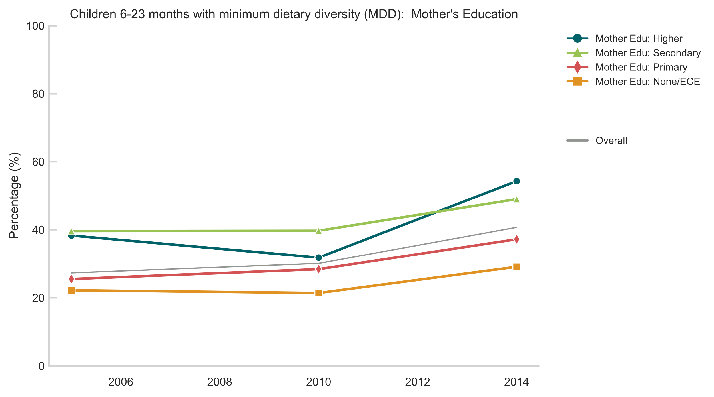
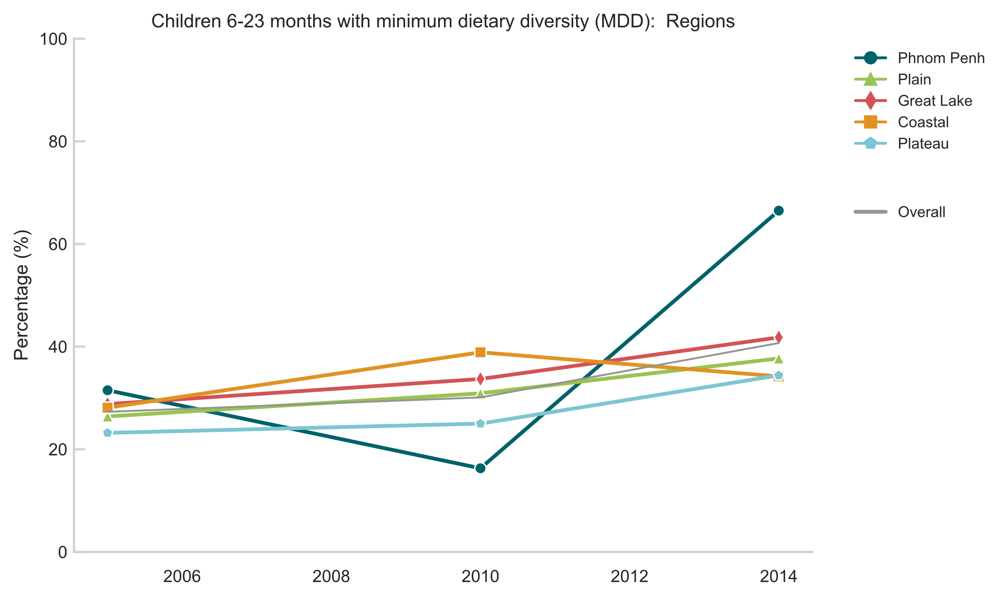
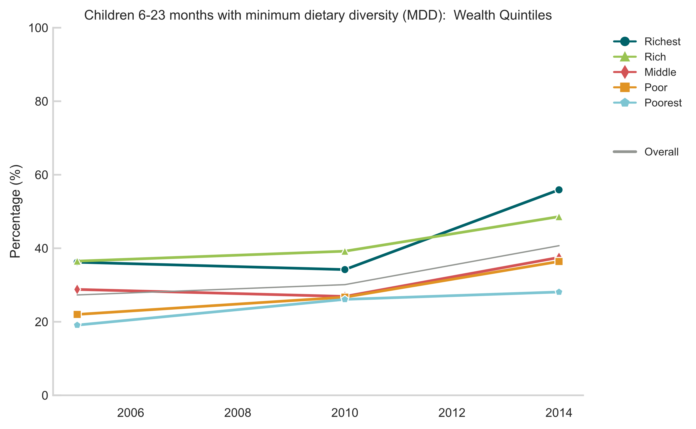
Minimum Dietary Diversity (6-23 mos)
Slight overall improvement in dietary diversity, particularly in urban areas and Phnom Penh
No significant narrowing of equity gaps
Definition: Percentage of children 6–23 months of age who consumed foods and beverages from at least five out of eight defined food groups during the previous day.

Slide 15
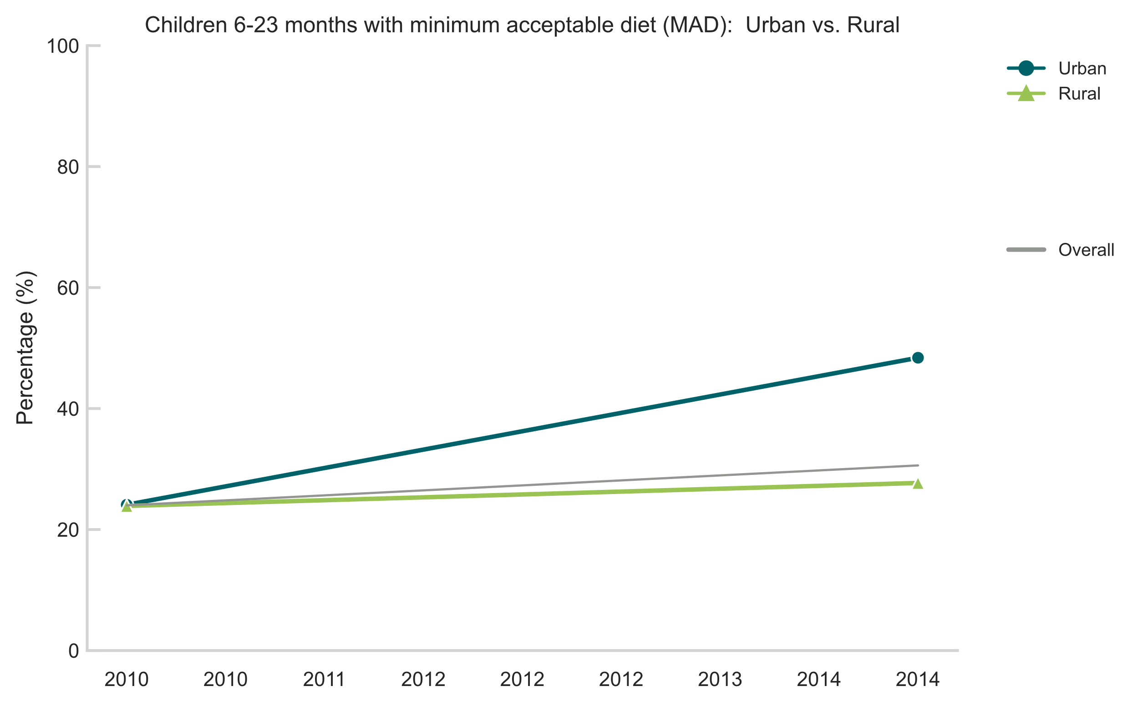

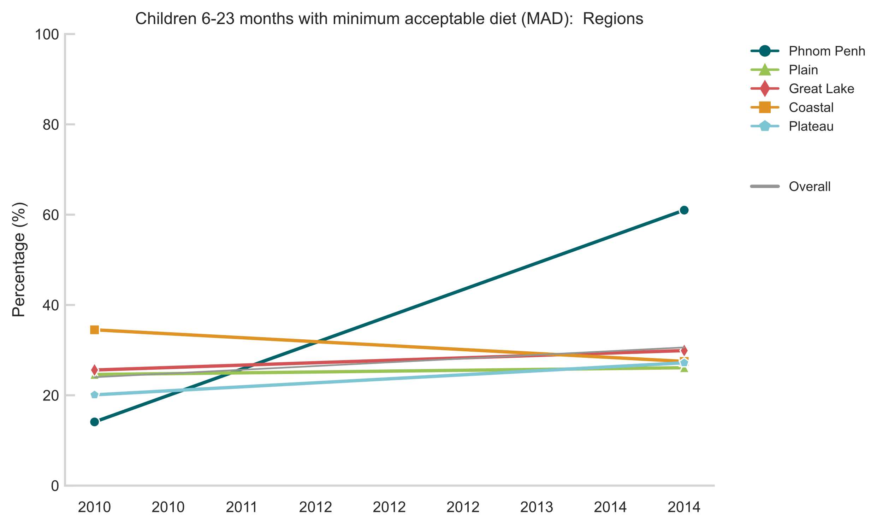

Minimum Acceptable Diet (6-23 mos)
Statistically significant widening of MAD equity gap for both urban/rural and according to region (driven in part by rapid improvement in Phnom Penh)
Given that MMF was fairly static of the review period, the improvement in urban areas (especially Phnom Penh) must owe largely to more children 6-23 month in these areas eating a more diverse diet (see MDD in previous slide)
Definition: Percentage of children 6–23 months of age who consumed a minimum acceptable diet during the previous day.

Slide 16




Stunting (0-59 mos)
Substantial overall improvement between 2000 and 2014 (2021 prelim results suggest even further gains)
No significant narrowing among equity subgroups
In contrast to Lao PDR, rate of improvement sustained for all equity subgroups
Very wide gaps persist
Definition: Percentage of children with length/height-for-age less than 2 SD below the WHO Child Growth Standards median

Slide 17




Wasting (0-59 mos)
Overall trend has not improved much since 2005
No material improvements in equity gaps (due in part to narrow range of the indicator overall)
Definition: Percentage of children with weight-for-length/height less than 2 SD below the WHO Child Growth Standards median
Notes:
Small sample size for mother education = Higher in 2000

Slide 18




Overweight (0-59 mos)
Gradual increase since 2005 though data is quite noisy
Increase among children from higher socioeconomic settings, particularly Urban areas, Richest households, but from low base
Definition: Percentage of children with weight-for-length/height more than 2 SD below the WHO Child Growth Standards median

Slide 19
Reflections/Trends
Women’s indicators, specifically those measuring health access, show remarkable improvement and do not appear to be as dependent on socioeconomic background as in Lao PDR (in this way more similar to Viet Nam) :
Healthcare access is improving for (most) women and improving dramatically for women on the lower end of the socioeconomic spectrum
Existing gaps largely confined to measures of high-quality care (e.g., ANC 3 components)
“Over medicalization” of birth could be playing a role in some observed deteriorations in more behavioral indicators (e.g., early initiation of BF)
Like in Lao PDR and Viet Nam, children’s indicators were different according to behavioral (secular trends of less breastfeeding over time) and those linked to development (e.g., improved stunting outcomes across SES spectrum)
Lack of improvement in wasting rates suggests that meaningful improvements still possible for the 0-59 month group
Notes:
Lao PDR
Conclusions:
Overall, we found disparities in almost all studied maternal and child indicators in various aspects (e.g., ethnicity, education, income, place of residence) and over time.
Reflections:
Mothers’ indicators reflect more health system issues and, overall, are improving (equity gaps shrinking) . Health system quality has improved (ANC 3 components) , and access to the health system is also improving, except for certain marginalized groups .
Children’s indicators reflect more individual/ household behavior and are mixed depending on the influences of underlying societal shifts. Exclusive breastfeeding under six months is improving, wealthy/well-educated, even eclipsing other households . Continue breastfeeding may reflect women’s labor force participation and cultural shifts (e.g., the richest presumably used formula more in the past, whereas now it appears to be more prevalent among middle/upper-middle classes) . Quality of diet (diversity) is still very much an economic issue .

Slide 20
Methodology
Data Sources
Cambodia: DHS 2000, 2005, 2010, 2014
Software
Python, v 3.10.4

